Slide 1
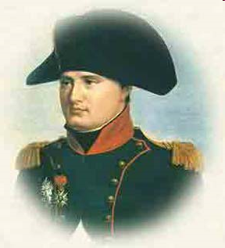
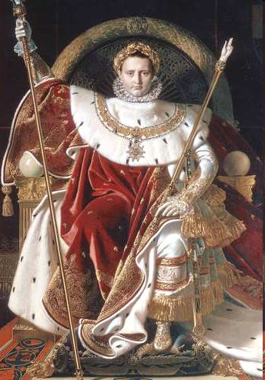
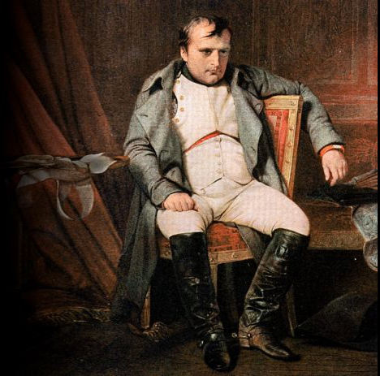
Napoleon Bonaparte (1769 -1821)

Slide 2
VIdeo
http://www.biography.com/people/napoleon-9420291

Slide 3
Napoleon’s Early Days
born in Corsica in
August 1769 in a high
social class
Was sent to military
Academy in France and
Graduated at 16.
During the French
Revolution he served the
Revolutionary Army.

Slide 4
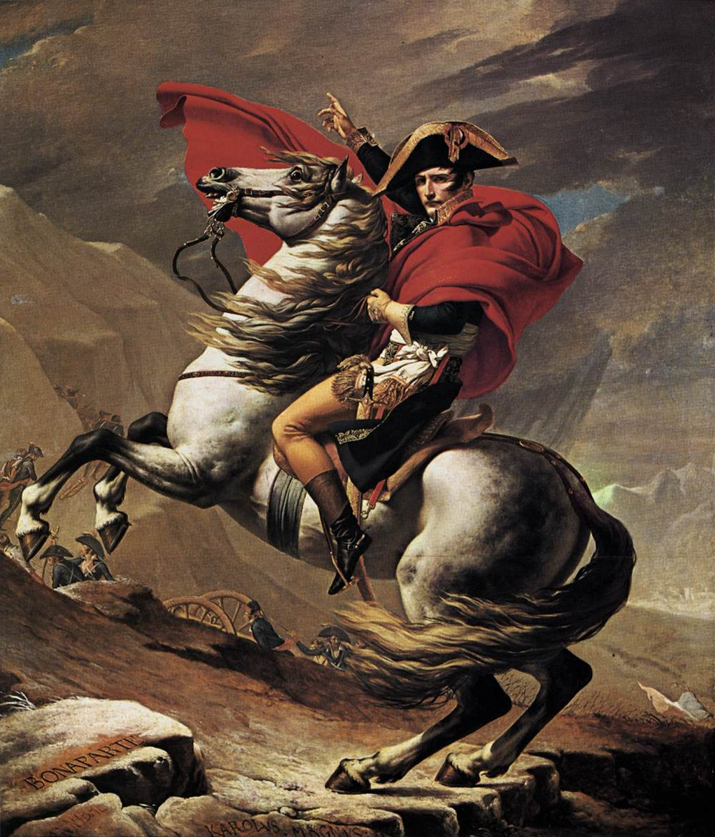
“I am no ordinary man.”
Napoleon rose quickly
in the army during the
revolution because so many
officers fled France.
By age 27, Napoleon was
a general and soon received
command for an invasion of
Italy.
He won several brilliant
victories over the Austrians.

Slide 5
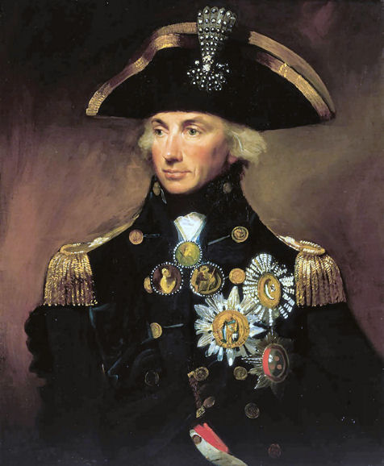
In 1798, Napoleon invaded Egypt
->because it was a vital lifeline to British outposts in India.
Napoleon quickly defeated the Egyptian army. However, the British fleet, under Admiral Horatio Nelson, destroyed the French fleet in the battle of the Nile.
Horatio Nelson (1758-1805)

Slide 6
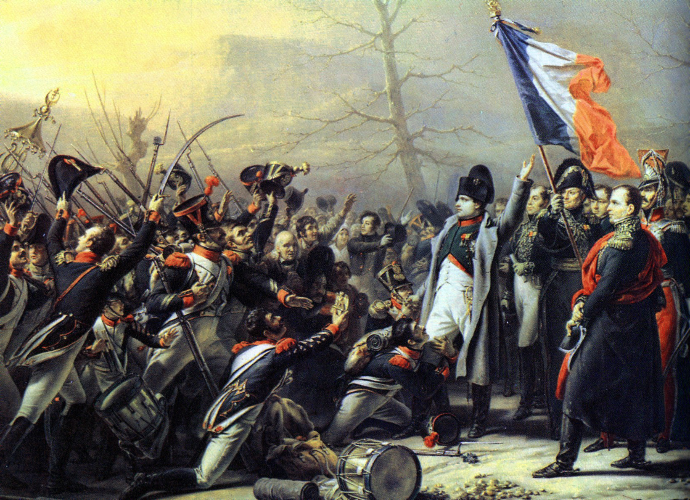
After, Napoleon
returned to Paris.
The French people were
not fully aware of the
losses in Egypt, and they
welcomed him as a hero.
In Paris, Napoleon found that many people were dissatisfied with the Directory. With the help of troops loyal to him, he and two directors did a “coup d’état” in November, 1799.

Slide 7
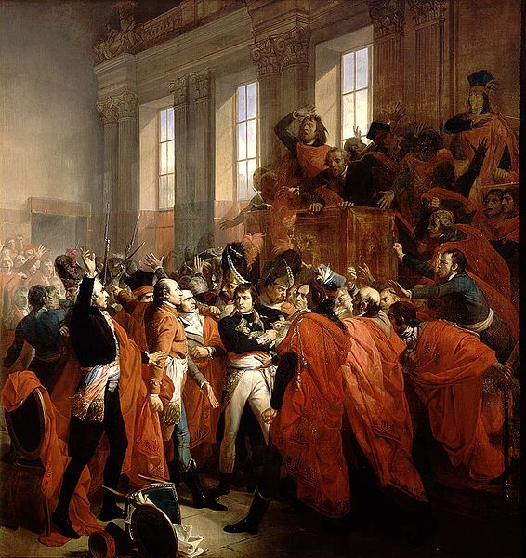
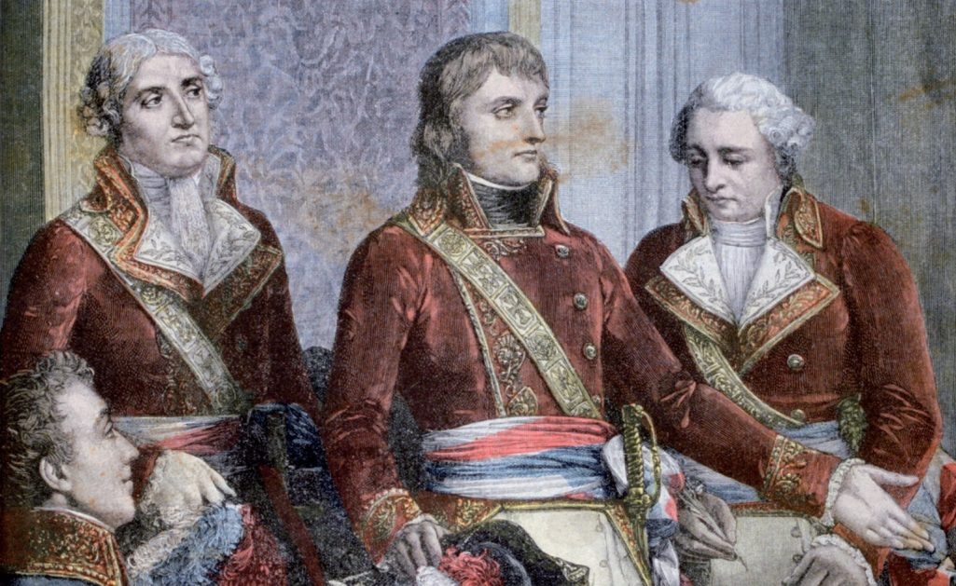
The Consulate (1799-1804)
-> Directory was replaced by a Consulate, which was three men who ran the government.
The Consulate was not much more effective, but it was soon dominated by one man… Napoleon Bonaparte. He claimed
power from the Consulate, by becoming First Consul in 1800
Coup-d´Etat

Slide 8
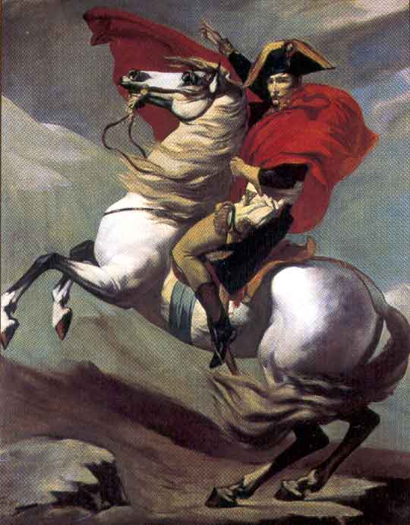
Napoleon’s Domestic Policy
By 1804, Napoleon had gained
almost absolute power and he
continued many reforms of the
revolution.
But at the same time, he kept
firm personal control of the
government.

Slide 9
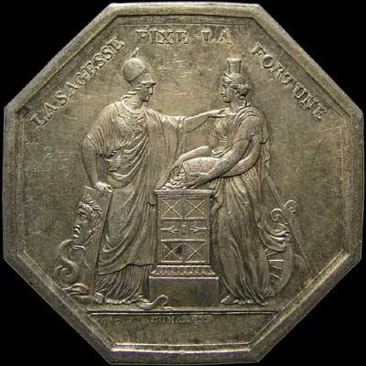
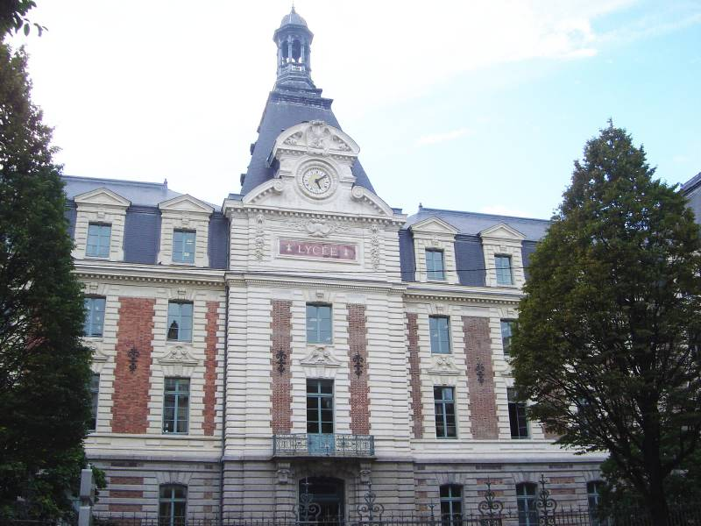
Napoleon Established..
A law requiring all
citizens to pay taxes
2.Banque de France (1800)
to deposit taxes issued money and made loans to businesses.
3. Education reform :
Lycée (1801).
->Initially enrolled the most talented students and
trained the nation’s future bureaucrats.

Slide 10
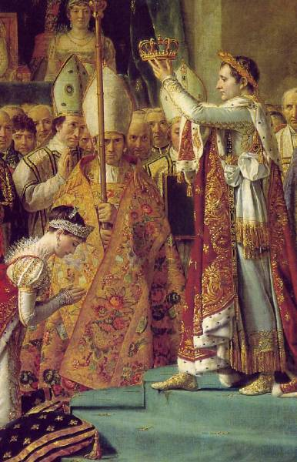
Emperor Napoleon
In 1804, Napoleon became “Emperor of the French.”
-> As Pope Pius VIII prepared to crown the emperor, Napoleon took the crown and placed it on his head himself. By this gesture, Napoleon showed that he did not bow to any authority.
-> He then proceeded to crown his wife, the Empress Josephine.

Slide 11
Code Napoleon, 1804
It influenced French law to the present.
It divides civil law into :
Personal status/ Property/acquisition of property.
Purpose :
-> Reform the French legal code to
reflect the principles of the Fr. Rev.
“all men were equal before the law and
guaranteed freedom of religion as well as a
person’s right to work in any occupation”
-> Create one law code for France.

Slide 12
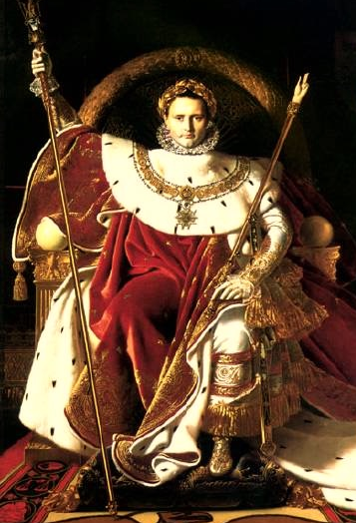
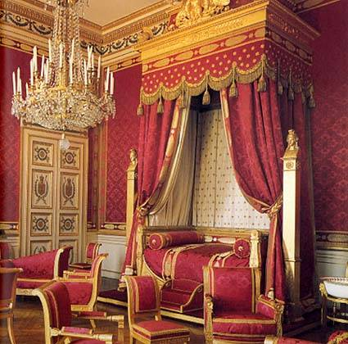
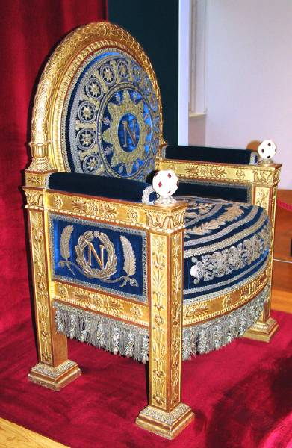
Napoleon’s Bed Chamber
Napoleon’s Throne

Slide 13
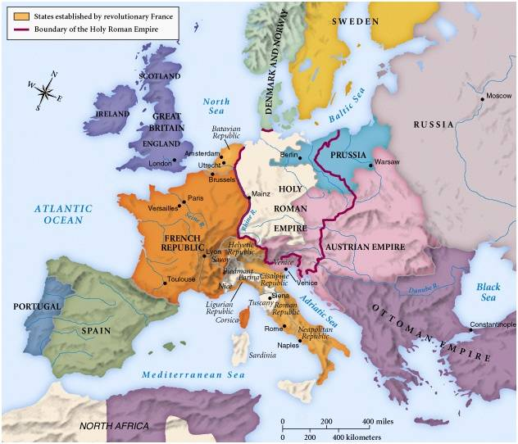
The Empire of Napoleon
-> In the early
1800s, France
fought all the
major European
powers.
-> Napoleon
usually kept
the European
powers divided
so they could not
unite against him.
Europe in 1800

Slide 14
Europe under French rule
-> Napoleon helped spread the ideas of the French Revolution across Europe.
-> He introduced :
religious toleration
abolished serfdom
the Napoleonic Code into law
reduced the power of the Catholic Church
-> imposed high taxes to finance his continuing conflict with Britain (lost much support).

Slide 15
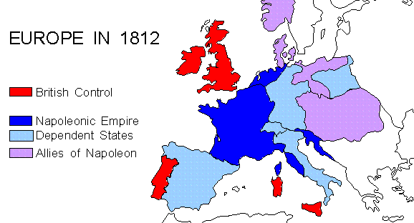
From 1807 to 1812, Napoleon was at the height of his power. He controlled an empire that stretched from France to the borders of Russia

Slide 16
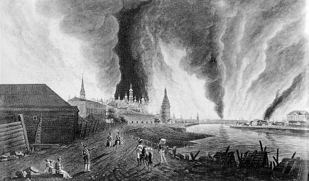
The Emperor’s Downfall
In 1812, Napoleon decided to invade Russia
->army of over 500,000 soldiers
The Russians refused to stand and fight.
-> They forced Napoleon to lead his army deeper into Russia.
The army progressed but When Napoleon entered Moscow, he found
the Russian capital in
flames.
-> realized he could
not feed and house his
army in Moscow
-> he ordered a retreat.

Slide 17
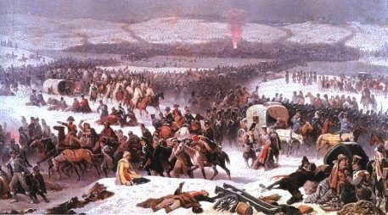
Cold Russian winter turned the French victory into a disastrous defeat.
-> Thousands of Napoleon’s soldiers starved or froze to death.
-> The Russian army attacked the stragglers

Slide 18
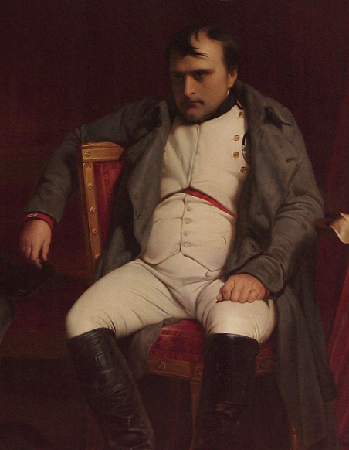
A powerful alliance made up of Britain, Austria, Russia, and Prussia pounced on the weakened French army as it limped out of Russia.
Napoleon rushed home to raise a new army, but his efforts failed. In March 1814, the allies captured Paris.
Napoleon abdicated and went into exile on the island of Elba, off the coast of Italy.

Slide 19
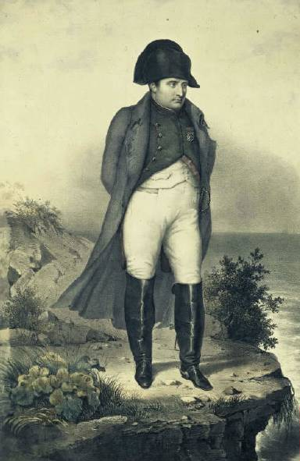
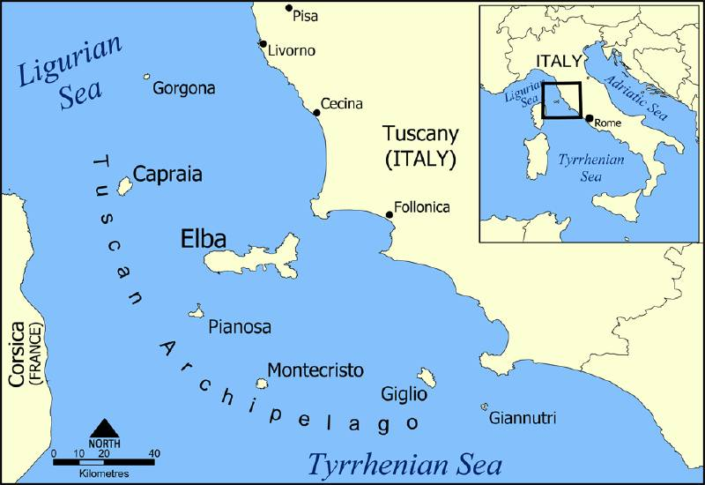
Napoleon in Exile on Elba

Slide 20
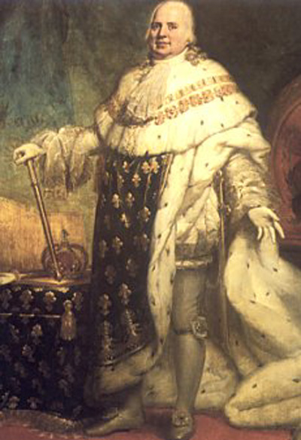
-> the monarchy was restored, In 1814, Louis XVIII.
He issued a constitution that :
- provided for equality under the law for all citizens
- an elected legislature
- religious freedom
- kept the Napoleonic Code.
Many émigrés returned to France and demanded revenge on supporters of the French Revolution.
Napoleon took advantage of the resulting disturbances to return to Paris.
Louis XVIII (1755-1824)

Slide 21
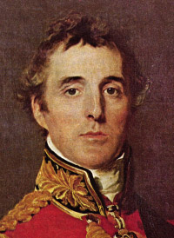
In March 1815, he again proclaimed himself emperor. Discontented soldiers rallied to his side. For 100 days, he worked to rebuild the French army; but the European allies acted swiftly.
In June 1815, a joint British and Prussian army led by the Duke of Wellington defeated the French at Waterloo.
Duke of Wellington (1769-1852)

Slide 22
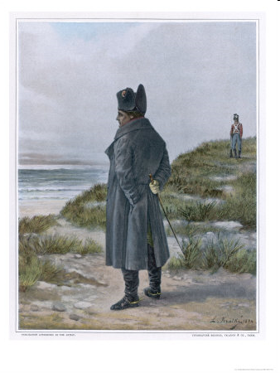
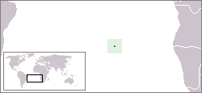
Napoleon’s
Final Exile …
… to the island of St. Helena in the Atlantic, where he died in 1821.

Slide 23
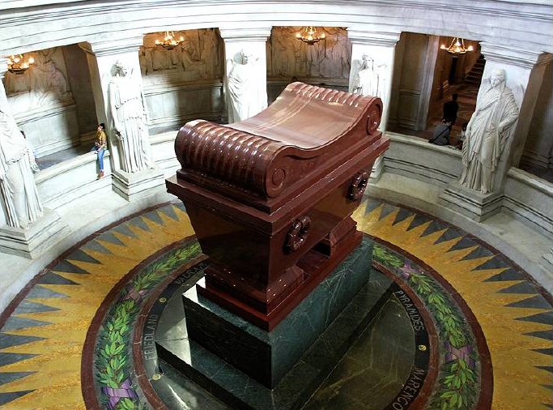
Napoleon’s Tomb

Slide 24
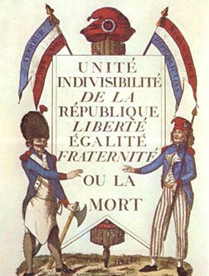
Under Napoleon Bonaparte
End of absolutism
Power of nobles ended
Peasants became landowners
The concept of Nationalism began to become popular
Enlightenment ideals
Napoleon’s Rise to Power
The Napoleonic Code
Establishment of the Bank of France
Reconciliation with the Catholic Church
Heavy Censorship
Napoleon’s “Art of War”
Reform the education
Notes:
As is the case with all historical events, opinions may vary on their significance or impact. What is agreed upon is that the Revolution brought an end to absolutism in France. Even when the monarchy was restored, it was not absolutist in nature. With the abolition of feudal privileges, the nobles lost their power and eventually their lands. The peasants and middle class came to possess land for the first time, and France became a nation of small landowning farmers.
The Revolution and the foreign wars associated with it also gave the French people a strong sense of national identity. Loyalties had shifted from a king or queen to the nation. This “nationalism” that began in France was spread by revolutionary and Napoleonic armies to the rest of Europe. The struggle for national liberation became one of the most important themes of 19th- and 20th-century European and world politics.
The Declaration of the Rights of Man was an outstanding example of the expression of Enlightenment ideals concerning freedom, equality, and rights. These ideals, along with the notion of equality before the law, would provide the basis for reform movements and new political philosophies in the 19th century.

