Slide 1
The Directory and Napoleon
French Revolution
Social Studies 9
Prince of Wales Secondary
Ms. Underwood

Slide 2
Phases of the French Revolution
National Assembly (1789-1791)
Legislative Assembly (1791-1792)
Convention (1792-1795)
Directory (1795-1799)
Notes:
Reign of Terror occurred in the Convention phase.

Slide 3
The Thermidorean Reaction
After the Terror ended in 1794, the constitution changed yet again.
The JACOBINS and the SANS-CULLOTTES were forced out of power and Politicians tried to find a moderate form of government that French people would support.
It was decided that there should be five directors who would see that laws were carried out.
The new government, the Directory, had serious problems to deal with and by 1798 were in serious trouble. They had reached crisis point…

Slide 4
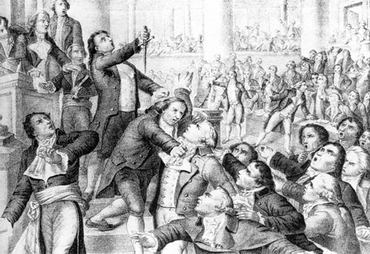
9 Thermidor meeting of the National Convention

Slide 5
Political Crisis
The government were running out of money – the foreign wars they were fighting were costly.
There were plots from royalists and extreme revolutionaries.
There were severe food shortages.
France’s armies had been badly defeated in wars in Italy.

Slide 6
Crisis Responses
As things got worse for the Directory in France, one of the Directors (government leaders) began to look round for a general who could control France.
Throughout History army generals have tried to take control of governments in crisis, and Robespierre had even warned of a ‘coup d’état’ in 1792 when he said: “Put yourself on guard against your generals, or a strong citizen might gain power and one day become your master.”

Slide 7
Napoleon Bonaparte
The choice fell on Napoleon Bonaparte – one of France’s most successful military generals.
He had proved himself a brilliant general in wars across Europe and Africa and this had made him famous and popular in France.
In 1799, Napoleon secretly left his armies who were still fighting in Egypt for France.
When he landed, people of all opinions welcomed him. On 11th November 1799, Napoleon seized power.

Slide 8
Who Was Napoleon?
Born in Corsica in 1769, son of a noble.
Entered a military college in 1784.
At the age of 16, became 2nd Lieutenant in the artillery.
Became sympathetic to the revolution and led attacks against royalist strongholds… put down a proroyalist coup in 1795 in Paris. Was promoted to Major General.
Became Commander of the French army, fighting in Austria, Italy, Britain

Slide 9
Who Was Napoleon?
Was fighting in Egypt in 1799 and heard of the military crisis facing France so left his troops behind return to France.
Seized control of the country in a coup d’etat.
A new constitution was introduced, and Napoleon was made First Consul of France.
In 1804, in the presence of the Pope, Napoleon crowned himself Emperor.

Slide 10
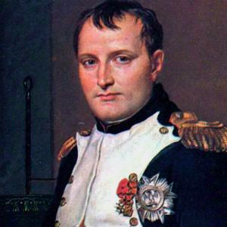
Napoleon

Slide 11
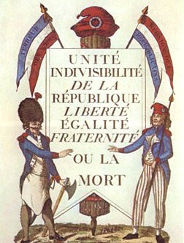
Legacies of the French Revolution
End of absolutism
Power of nobles ended
Peasants became landowners
Nationalism
Enlightenment ideals
Notes:
As is the case with all historical events, opinions may vary on their significance or impact. What is agreed upon is that the Revolution brought an end to absolutism in France. Even when the monarchy was restored, it was not absolutist in nature. With the abolition of feudal privileges, the nobles lost their power and eventually their lands. The peasants and middle class came to possess land for the first time, and France became a nation of small landowning farmers.
The Revolution and the foreign wars associated with it also gave the French people a strong sense of national identity. Loyalties had shifted from a king or queen to the nation. This “nationalism” that began in France was spread by revolutionary and Napoleonic armies to the rest of Europe. The struggle for national liberation became one of the most important themes of 19th- and 20th-century European and world politics.
The Declaration of the Rights of Man was an outstanding example of the expression of Enlightenment ideals concerning freedom, equality, and rights. These ideals, along with the notion of equality before the law, would provide the basis for reform movements and new political philosophies in the 19th century.

