Slide 1
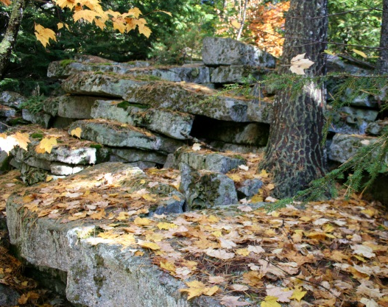
First Nations Cultures of North America – People of the Eastern Woodlands
Social Studies 9
Prince of Wales Secondary School
Notes:
Pictures with reflection and blurred background
(Basic)
To reproduce the picture effects on this slide, do the following:
On the Home tab, in the Slides group, click Layout, and then click Blank.
On the Insert tab, in the Images group, click Picture.
In the Insert Picture dialog box, select a picture and then click Insert.
Select the picture. Under Picture Tools, on the Format tab, in the Size group, click the arrow below Crop, point to Crop to Shape, and then under Rectangles click Round Diagonal Corner Rectangle.
Also under Picture Tools, on the Format tab, in the Size group, click the Size and Position dialog box launcher. In the Format Picture dialog box, resize or crop the image so that the height is set to 2” and the width is set to 2.4”. To crop the picture, click Crop in the left pane, and in the right pane, under Crop position, enter values into the Height, Width, Left, and Top boxes. To resize the picture, click Size in the left pane, and in the right pane, under Size and rotate, enter values into the Height and Width boxes.
Also in the Format Picture dialog box, click Reflection in the right pane, and in the Reflection pane, in the Presets list, click Half Reflection, Touching.
On the Insert tab, in the Images group, click Picture.
In the Insert Picture dialog box, select a different picture and then click Insert. Repeat this process until there are three pictures on the slide.
Select the second picture. Under Picture Tools, on the Format tab, in the Size group, click the Size and Position dialog box launcher. In the Format Picture dialog box, resize or crop the image so that the height is set to 2” and the width is set to 2.4”. To crop the picture, click Crop in the left pane, and in the right pane, under Crop position, enter values into the Height, Width, Left, and Top boxes. To resize the picture, click Size in the left pane, and in the right pane, under Size and rotate, enter values into the Height and Width boxes.
Select the third picture. Under Picture Tools, on the Format tab, in the Size group, click the Size and Position dialog box launcher. In the Format Picture dialog box, resize or crop the image so that the height is set to 2” and the width is set to 2.4”. To crop the picture, click Crop in the left pane, and in the right pane, under Crop position, enter values into the Height, Width, Left, and Top boxes. To resize the picture, click Size in the left pane, and in the right pane, under Size and rotate, enter values into the Height and Width boxes.
Select the first picture. On the Home tab, in the Clipboard group, click Format Painter. With the Format Painter cursor, on the slide, click the second picture.
Select the first picture. On the Home tab, in the Clipboard group, click Format Painter. With the Format Painter cursor, on the slide, click the third picture.
Press and hold CTRL, and then select all three pictures. On the Home tab, in the Drawing group, click Arrange, point to Align, and then do the following:
Click Align Selected Objects.
Click Align Middle.
To reproduce the background effects on this slide, do the following:
On the Insert tab, in the Images group, click Picture.
In the Insert Picture dialog box, select a picture and then click Insert.
Select the picture. Under Picture Tools, on the Format tab, in the Size group, click the Size and Position dialog box launcher. In the Format Picture dialog box, resize or crop the image so that the height is set to 7.5” and the width is set to 10”. To crop the picture, click Crop in the left pane, and in the right pane, under Crop position, enter values into the Height, Width, Left, and Top boxes. To resize the picture, click Size in the left pane, and in the right pane, under Size and rotate, enter values into the Height and Width boxes.
Also in the Format Picture dialog box, click Artistic Effects in the left pane, and in the Artistic Effects pane, do the following:
Click the button next to Presets and then click Blur (second row, fifth option from the left).
In the Radius box, enter 30.
On the Home tab, in the Drawing group, click Shapes, and under Rectangles click Rectangle (first option from the left).
Drag to draw a rectangle on the slide.
Select the rectangle. Under Drawing Tools, on the Format tab, in the Size group, enter 7.5” into the Height box and enter 10” into the Width box.
Also under Drawing Tools, on the Format tab, in the Shape Styles group, click Shape Fill, point to Gradients, and then click More Gradients. In the Format Shape dialog box, click Fill in the left pane, select Gradient fill in the Fill pane, and then do the following:
In the Type list, select Radial.
In the Direction list, select From Center.
Under Gradient stops, click Add gradient stops or Remove gradient stops until two stops appear in the slider.
Also under Gradient stops, customize the gradient stops as follows:
Select the first stop from the left in the slider, and then do the following:
In the Position box, enter 0%.
Click the button next to Color, and then under Theme Colors click White, Background 1 (first row, first option from the left).
In the Transparency box, enter 60%.
Select the second stop from the left in the slider, and then do the following:
In the Position box, enter 100%.
Click the button next to Color, and then under Theme Colors click White, Background 1 (first row, first option from the left).
In the Transparency box, enter 0%.
Also in the Format Shape dialog box, click Line Color in the right pane, and in the Line Color pane select No Line.
Select the shape. On the Home tab, in the Drawing group, click Arrange, point to Align, and then do the following:
Click Align to slide.
Click Align Middle.
Click Align Center.
On the Home tab, in the Drawing group, click Arrange, and then click Send to Back.
Select the background picture. On the Home tab, in the Drawing group, click Arrange, and then click Send to Back.

Slide 2
Shape of the day
Review of the Inuit people
Introduction to the people of the Eastern Woodlands (ppt) – fill in info on chart as we go through the slides.
Shade in Inuit and Eastern Woodlands territory on map.
Who are the Iroquois handout
Be prepared to play lacrosse next class (weather permitting).
Homework:
Fill in chart on Inuit people
Journal question
Readings: pg 193 – 197… plus 188-192 if not already done.

Slide 3
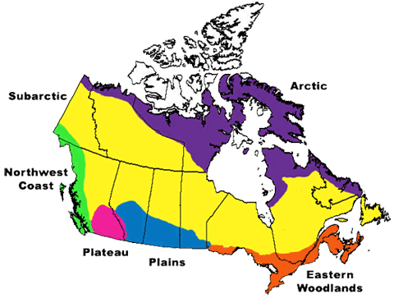
People of the Eastern Woodlands

Slide 4
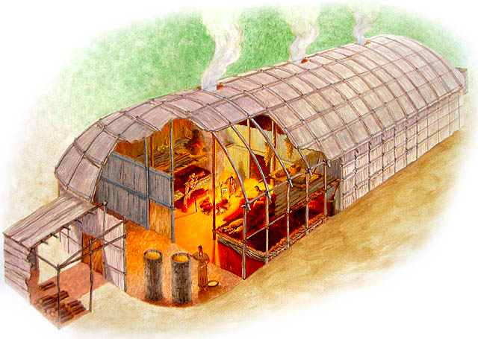
The Iroquois
The Iroquois prefer to be called the Haudensaunee.
This translate to the “people of the long house”
Iroquois translates to “black snakes” from Huron/French
Why would the Iroquois prefer the former name?

Slide 5
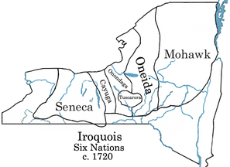
The Iroquois

Slide 6
Hunter, Gatherer, Farmer
Which of the above do you think the Haudenosaunee people are considered? Why?
What were the Inuit?

Slide 7
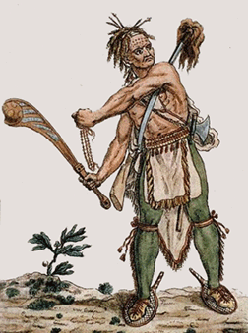
Hunters
Refers to a way of life that is:
Relatively mobile or nomadic
Follows resources
Based on exploitation of animals
In such societies, hunting is typically done by men
Tend to have low population densities?
Why do you think that this is the case?
There is rarely a surplus of food.

Slide 8
Gatherers
Refers to a way of life that is:
Mobile. Must go where the fruit, berries, vegetables, and roots, etc are available.
Based on the exploitation of plants.
Gathering is typically done by women.
Tend to have low population densities.
There is rarely a surplus of food.
Being nomadic would make it difficult to do so anyways.
Why do you think that men were the hunters and women were the gatherers?

Slide 9
Farmers
Society or culture were able to grow enough food to store.
Allowed permanent villages to be established.
Most agricultural people continued to do some hunting and gathering.
Some would farm during the temperate months and hunt during the winter.
The Iroquois were a farming society.

Slide 10
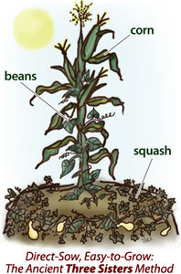
Iroquois Farming
Women were primarily responsible for farming.
The main agricultural products were the 3 sisters: corn, beans, and squash.
Corn was planted in rows between stumps.
Squash was planted on the ground to keep it moist and to prevent weeds from sprouting up.
Beans were planted beneath the corn so they could climb it as it grew.

Slide 11
Society and Governance
Women were quite important.
As many as 24 individual families made up of perhaps 200 people lived together in a maternal family.
The maternal family was led by an elderly female.
Leadership:
A council of 50 chiefs who were called sachems were selected by leader of the maternal families.
The council met when there were important decisions (ie. War).
The sachems were not great warriors.
A group of warrior chiefs were also formed – they were outstanding military leaders.
The Iroquois did not believe that one person had more importance than the other.

Slide 12
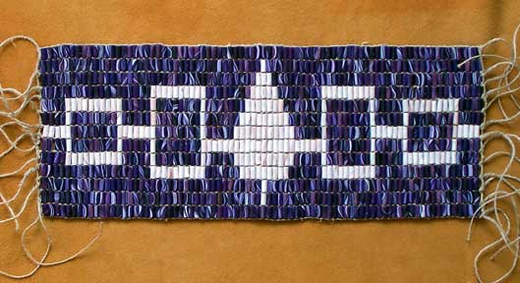
Economy
Very important to this culture was wampum.
Wampum belts and necklaces were made from wampum beads (white and purple shells).
The Iroquois used wampum to trade with the early Europeans.
Wampum was used as a form of communication between tribes.
They design told a story indicating the reason why it was made.
All messengers would carry wampum when visiting other tribes.

Slide 13
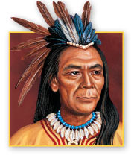
Beliefs and Customs
The legend of Hi-a-wat-ha is believed to be the founder of the Iroquois Confederacy.
He descended from the skies, and took up his abode with the Onondagas.
He taught them the principles that are now at the core of the Confederacy.
The art of good living, the value and strength of mutual friendship and goodwill, and the advantages of having fixed habitations and the cultivation of the earth.
The Five Nations
Read the Five Nations Story

Slide 14
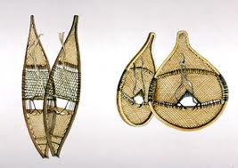
Transportation
Snowshoes were used in the winter so they could run in the snow without falling through the snow.
Deerskin and hickory wood were used to make the snowshoes.
Canoes were built to carry food, clothing, and furs.
The traveled on rivers, lakes, and streams.
Canoes were made of elm, birch, white ash, and cedar bark.

Slide 15
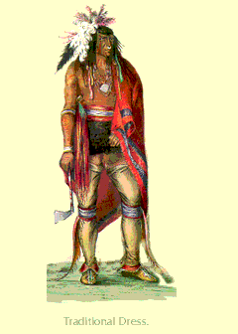
Clothing
Traditionally, the people used furs from the woodland animals and hides of elk and deer.
They also used corn husks and wove plant and tree fibers to produce articles of clothing.
In the winter the men wore shirts, leggings, and moccasins made of buckskin.
Women wore skirts they had woven.

Slide 16
Intro to a National Sport
https://www.youtube.com/watch?v=n1rvmAh155g

Slide 17
Lacrosse
One of the oldest organized sports in North America.
Began as a field sport or ritual played by aboriginals, but became popular with non-aboriginals in the mid 1800s.
Is Canada’s official summer sport.
A team sport in which players pass, catch, and carry a rubber ball, using sticks with a netted pouch at one end. The object is to accumulate points by shooting the ball into the opposing team's goal.

Slide 18
Lacrosse - Origins
The game was played by a large number of warriors on fields that could be over a kilometre long
It kept young men fit and strong for both war and hunting.
It could also be played to strengthen diplomatic alliances, support social conformity and economic equality, and honour the gods.
Lacrosse has changed significantly, and there are now four distinct games in Canada: men's field lacrosse, women's field lacrosse, box lacrosse, and inter-crosse.

Slide 19
Lacrosse - Haudenosaunee
The 2010 World Lacrosse Championships were notable for the absence of one of the strongest lacrosse teams in the world, the Iroquois Nationals.
The Iroquois Nationals represent the Haudenosaunee on both sides of the Canada–US border;
It is the only First Nations team that has been sanctioned to compete in international sporting competitions.
The team was accustomed to travelling with their Haudenosaunee passports, but British officials refused to allow them entry, stating that the passports were not acceptable forms of identification.
The Iroquois Nationals had competed in the world championships since 1998, winning fourth in 1998, 2002 and 2006.
However, as they did not play in 2010, they were automatically demoted to last place in the world standings.
After the team launched two appeals, the Federation of International Lacrosse announced in June 2013 that the Iroquois Nationals would compete in the elite Blue Division in the 2014 Championships
The Iroquois Nationals won bronze at the 2014 Championships
Canada won gold.

Slide 20
Picture Analysis

