Slide 1
European arrival in canada
Colonization of North America
Social Studies 9 – Prince of Wales Secondary

Slide 2
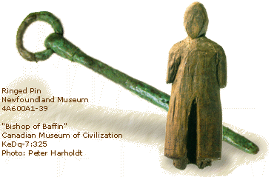
The First Explorer’s arrive in Canada: vikings
Evidence of landings in North America include sagas and the remains of Viking styles buildings and artifacts at L’Anse aux Meadows.
Came from Scandinavia (Sweden, Norway, Denmark).
Leif Erikson arrived in Newfoundland in about 1000 CE.
Attempts to establish a permanent colony failed (driven off by Natives).

Slide 3
Leif Erikson: The First to North aMerica?
http://www.history.com/topics/exploration/leif-eriksson

Slide 5
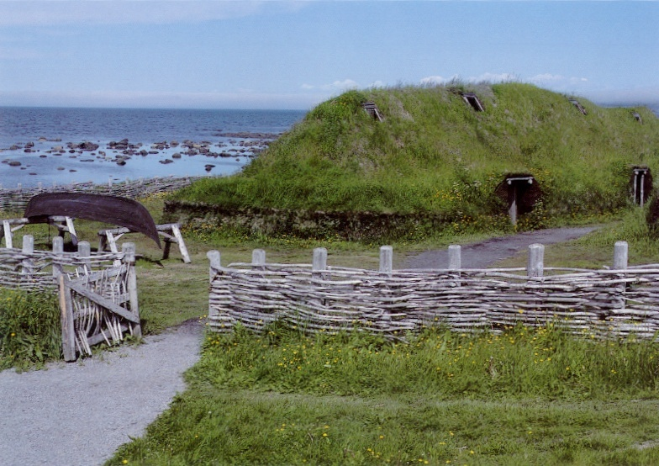
L’Anse Aux Meadows

Slide 6
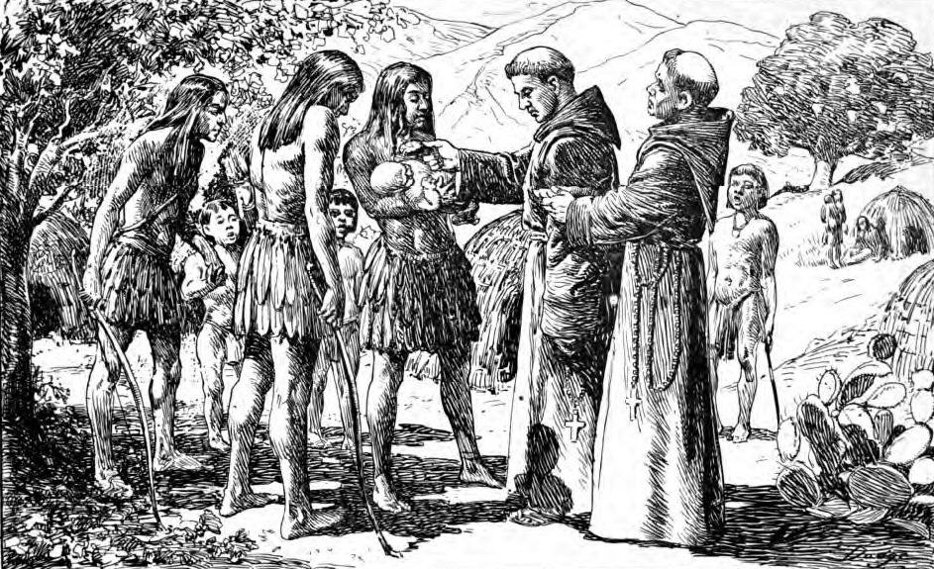
The Power Struggle and Exploitation For Resources
Colonialism – the extension of a nation’s sovereignty over territory beyond it’s borders by the establishment of either settler colonies or administrative dependencies in which indigenous populations are directly ruled or displaced.

Slide 7
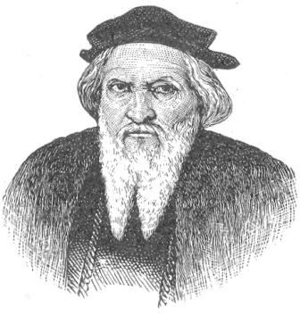
A Trade route to Asia
European countries are in direct competition with one another to find a route first.
1497 – John Cabot (Italian) sails for England under the English flag with Letter Patent of King Henry VII.
Landed at “New Found Land” and claimed it for England.
Discovers unprecedented amounts of cod fish.

Slide 8
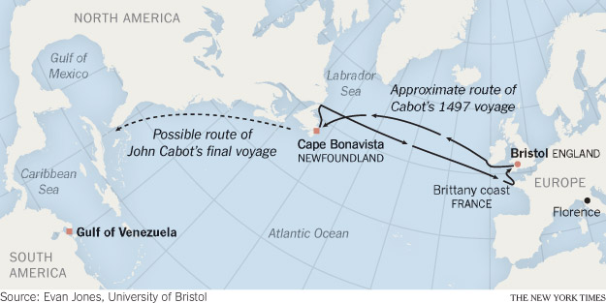
John Cabot: Arrives 1497

Slide 9
John Cabot:

Slide 10
John Cabot:

Slide 11
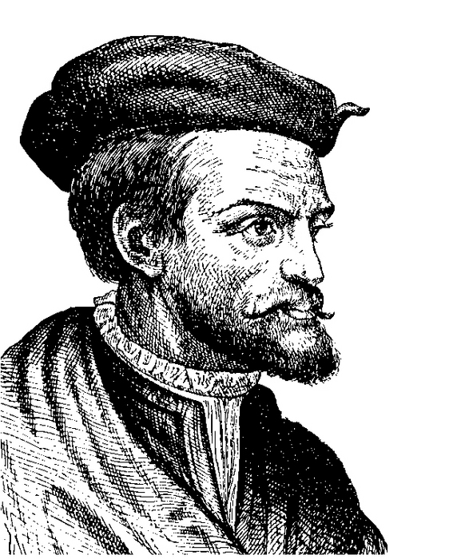
French Exploration
Jacques Cartier resumes French exploration in 1534.
Sails to the Gaspe Peninsulas and claims the territory for France.
In 1535, Cartier completes a 2nd voyage and returns to explore the area around the St. Lawrence river.
Enticed by his guides (Taigoagny & Domagaya), who talk of a land of gold and jewels called Saguenay.

Slide 12
French Exploration: Cartier
Travels down the St. Lawrence to Stadacona (Quebec).
Continued on to Hochelaga (Montreal).
Spent the winter at Stadacona, but was not prepared.
Many died of scurvy until Domagaya showed them how to make a tea of bark and needles which was rich in Vitamin C.
Cartier kidnaps Donnacona and takes some others with him to Europe.
Dies in France, perhaps due to lack of immunity to European diseases.
1541 – Cartier’s 3rd voyage is approved.
Took home diamonds (quartz) and gold (pyrite).
1542 – Roberval is authorized to set up a colony and sets sail.
Struggled to survive the winter, lost 50 settlers.
Iroquois refused to trade food and threatened war.

Slide 13
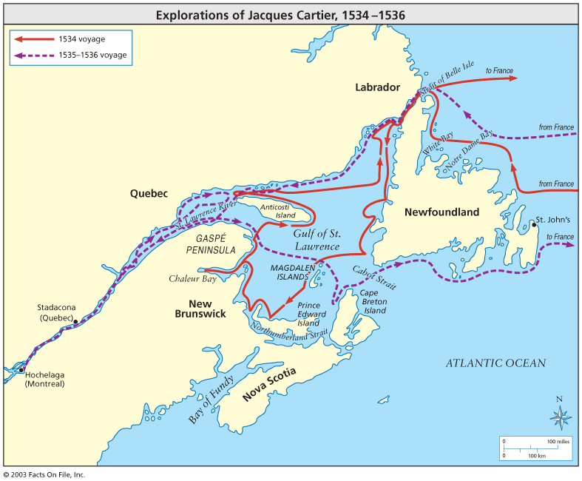

Slide 14
Jacques Cartier

Slide 15
Naming a Nation?

Slide 16
Fishing as a North American Industry
Fishing fleets regularly summering along the Atlantic coast by the early 1500s.
There is a demand for fish because much of Europe is Catholic and the religion requires that you not eat meet frequently (165 days/year).
Fishing the Grand Banks is risky:
20 days to reach the fishing grounds from Europe
Often heavy fog where the Labrador current meets the Gulf Stream
Ice is carried down by the Labrador current from glaciers
Too cold to fish in the winter.
Camps established to preserve the fish, either by drying or salting (esp. English).

Slide 17
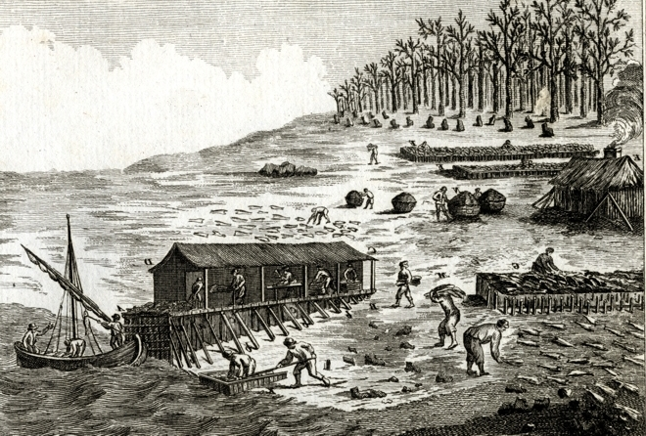
Fishing Camp

Slide 18
The Fur Trade: Early Beginnings
Hopes of discovering gold and jewels fade.
Furs are available in abundance in the new colony.
Wolf, fisher, marten, lynx, and beaver pelts are highly coveted.
Easy to obtain pelts; Natives are initially happy trading furs.
New goods from Europe are traded: knives, hatchets, pots, beads…
The French are making huge profits off of the exchanges.

Slide 19
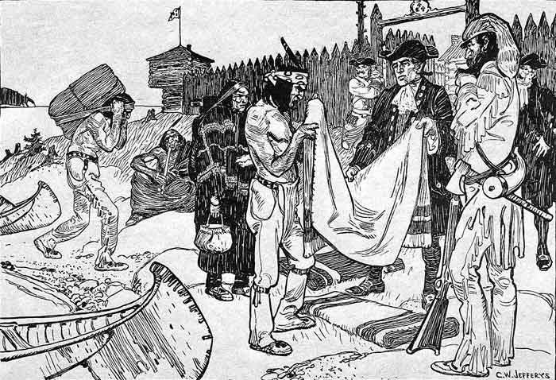

Slide 20
Profits Possible: Others Interested
English are searching for the Northwest Passage, but explored the Arctic, claiming territories along the way.
Explorers include: Frobisher, Baffin, and Davis.
1583 – Humphrey Gilbert claims Newfoundland, even though there were Portuguese and Basques already there.
1610 – Henry Hudson sails on behalf of the Dutch East India Company.
Interested in North American colonization.
Settled on the Hudson River → formed the colony of New Amsterdam (New York) → Lasted for 50 years.

Slide 21
The Fall of New Amsterdam

Slide 22
Assignment: Journal Entry
Read “Kidnapped Tour Guides” on pg. 222.
Imagine that you are either Taigoagny or Domogaya and write an account of your adventures/encounters with Jacques Cartier.
In your opinion have you been kidnapped?
Aim for a half of a page.

