Slide 1
First Nations People of North America
Ms. Underwood
Social Studies 9
First Nations People of North America

Slide 2
Musqueam Ancestral Territory
Before we begin our new unit of study, I would like to recognize that we are on the traditional, ancestral, and unceded territory of the Musqueam people.
The ancestors of the Musqueam people have lived off the Fraser River estuary for thousands of years.
Musqueam place names map.

Slide 3
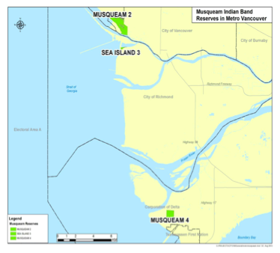
Musqueam Territory & Reserves

Slide 4
Origins of the First Peoples
How do people in various parts of the world explain how their cultures came to be??
Creation stories exist amongst many cultures throughout the world:
North American First Nations
Asia (Chinese – Pangu), India (Hinduism)
Egypt
Greek – Gaia, Chronus
The Bible (Genesis – “In the beginning god created the heaven and the earth”).
Resource

Slide 5
Scientific Explanations
Evolution
Darwin’s Theory of Evolution is the notion that all life is related and has descended from a common ancestor.
Complex creatures evolve from more simplistic ancestors naturally over time.
Out of Africa Theory
The theory argues that every living human being is descended from a small group in Africa, who then dispersed into the wider wider world.

Slide 6
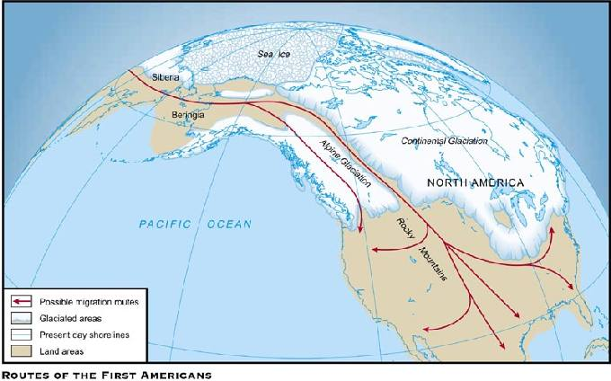
Ice Age Migration Routes

Slide 7
Ice Age Migration Routes
Humans are believed to crossed into the Americas before the end of the last ice age, when a natural land bridge called Beringia linked present day Siberia and Alaska.
During the coldest part of the ice age (23,000 – 19,000) years ago, vast glaciers blanketed much of the Northern hemisphere making travel south toward what is not the continental US virtually impossible.
14,000 years ago, as the climate warmed, a passible route opened along the Pacific coast.
2,500 years later, an ice-free corridor opened in the continental interior.

Slide 8
Canada a People History: Episode 1
Answer the following questions while viewing:
Why did the ocean level sink?
Where did the land bridge appear?
What happened to the ice cap that covered most of North America?
In what direction did the people migrate?
https://www.youtube.com/watch?v=27YTTx4mU28&noredirect=1
From 4:45

Slide 9
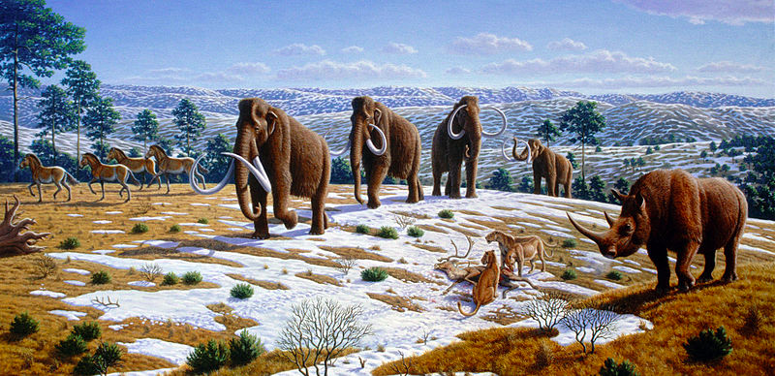
Ice Age Migration

Slide 10
First Nations Creation Stories
Each Native cultural group has its own creation stories to explain its’ origins.
There are many similarities between the stories including:
A Great Spirit that possess a creative power.
Three main themes:
A being emerges from the Earth’s womb.
An animal rises from the depths of the waters to form land.
The skies are created.

Slide 11
Cultural Significance
The Creation stories of each First Nations people expresses the way they see the world around them, and their relationship with it.
It is also a reflection of their traditional values.

Slide 12
Oral Traditions
Stories are told by elders.
Traditions are passed along orally from elders to younger generations in traditional dialects.
Little recorded or written history.
History is passed by word of mouth and often told in stories.
There is a movement toward restoring traditional languages in order to preserve the passing of tradition and history orally.

Slide 13
Creation Story Assignment
You will be randomly assigned a tribal creation story.
One volunteer will read the story aloud to the group.
As a group, you will turn the story into a skit.
Recognize that these stories are unfamiliar, but that we are respectful of the beliefs of others.
You may write a script if you feel it will be helpful.
Decide who the characters are and if a narrator is necessary.
Skits to be performed at the beginning of next block.

