Slide 1
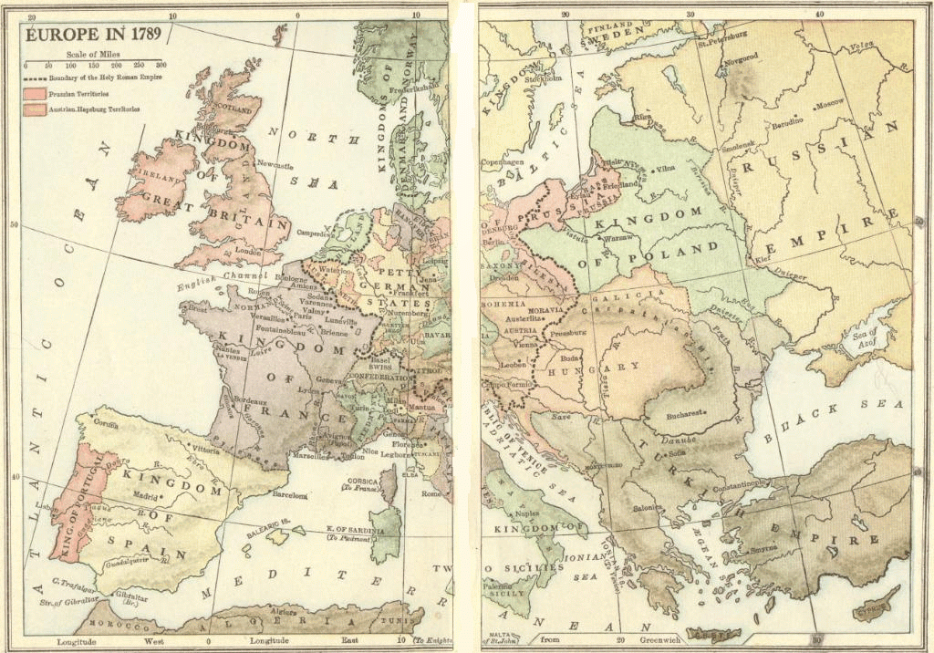

Slide 2
The French Revolution
Liberty, Equality, Fraternity
Play Marseilles

Slide 20
Estate | Population | Privileges | Exemptions | Burdens
First | Circa 130,000 High-ranking clergy | Collected the tithe Censorship of the press Control of education Kept records of births, deaths, marriages, etc. Catholic faith held honored position of being the state religion (practiced by monarch and nobility) Owned 20% of the land | Paid no taxes Subject to Church law rather than civil law | Moral obligation (rather than legal obligation) to assist the poor and needy Support the monarchy and Old Regime
Second | Circa 110,000 Nobles | Collected taxes in the form of feudal dues Monopolized military and state appointments Owned 20% of the land | Paid no taxes | Support the monarchy and Old Regime
Third | Circa 25,000,000 Everyone else: artisans, bourgeoisie, city workers, merchants, peasants, etc., along with many parish priests | None | None | Paid all taxes Tithe (Church tax) Octrot (tax on goods brought into cities) Corvée (forced road work) Capitation (poll tax) Vingtiéme (income tax) Gabelle (salt tax) Taille (land tax) Feudal dues for use of local manor’s winepress, oven, etc.

