Slide 1
The declaration of the rights of man
Social Studies 9

Slide 2
The National Assembly
Louis the XVI eventually had to accept that the National Assembly would form the governing body of France.
He ordered the 1st and 2nd Estates to join with the 3rd Estate (all estates would have equal representation in government.
All three estates were forced to work together to reform government in France.
Significant differences between the estates prevent significant progress.

Slide 3
Changes under the National Assembly
Abolishment of guilds and labor unions
Reforms in local government
Taxes levied based on the ability to pay
Many nobles left France and became known as émigrés
Declaration of the Rights of Man
Abolition of special privileges
Constitution of 1791
Equality before the law (for men)

Slide 4
Reforms of the National Assembly
The events in Paris and the countryside forced the National Assembly to act.
Working into the night of August 4th, delegates made many impassioned speeches in support of reform.
By the end of the night, most feudal customs had been abolished.
This marked the end of serfdom and tax exemption privileges of nobles.

Slide 5
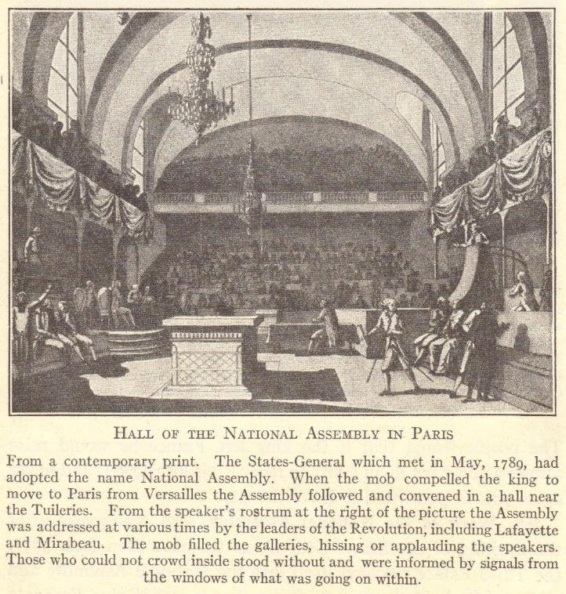
Notes:
The National Assembly convened in a hall near the Tuileries.

Slide 6
The declaration of the rights of man
The Declarations was passed on August 26, 1789.
It gave basic rights and freedoms to all of the men of France (but not yet women).
Such rights included were liberty, property, security, and resistance to oppression.

Slide 7
Declaration of the Rights of Man
Freedom of religion
Right of the people to create laws
Right to a fair trial
“Liberty, equality, fraternity!”
Freedom of the press
Guaranteed property rights
Freedom of speech

Slide 8
Declaration of the Rights of Woman
Journalist Olympe de Gouges argued in her Declaration of the Rights of Woman that women are equal citizens and should benefit from governmental reforms just as men did.
Madame Jeanne Roland also served as a leader in the women’s rights movement, and was able to heavily influence her husband (a government official).
Women did gain some rights during the French Revolution, but these were designed for purposes other than liberating women.
Women could inherit property, but only because doing so weakened feudalism and reduced wealth among the upper classes.
Divorce became easier, but only to weaken the Church’s control over marriage.

Slide 9
End of Special Privileges
Church lands were seized, divided, and sold to peasants
Civil Constitution of the Clergy required that Church officials be elected by the people, with salaries paid by the government
2/3 of Church officials fled the country rather than swear allegiance to this
All feudal dues and tithes were eradicated
All special privileges of the First and Second Estates were abolished

Slide 10
Reforms in Local Government
The 30 provinces and their “petty tyrants” (Intendants) were replaced with 83 new departments
Ruled by elected governors
New courts, with judges elected by the people, were established

Slide 11
Constitution of 1791
Democratic features
France became a limited monarchy
King became merely the head of state
All laws were created by the Legislative Assembly
Feudalism was abolished
Undemocratic features
Voting was limited to taxpayers
Offices were reserved for property owners
This new government became known as the Legislative Assembly

Slide 12
Legislative Assembly (1791-1792)
Royal family sought help from Austria
In June, 1791, they were caught trying to escape to Austria
Nobles who fled the revolution lived abroad as émigrés
They hoped that, with foreign help, the Old Regime could be restored in France
Church officials wanted Church lands, rights, and privileges restored
Some devout Catholic peasants also supported the Church
Political parties, representing different interests, emerged
Girondists
Jacobins

Slide 13
