Slide 1
Lesson 10

Slide 2
Four Phases (Periods) of the French Revolution
National Assembly (1789-1791)
Legislative Assembly (1791-1792)
Convention (1792-1795)
Directory (1795-1799)

Slide 3
The Legislative Assembly
In October 1791, the Legislative Assembly, elected under the new constitution, met for the first time.
The seating arrangements in the Assembly reflected divisions among the revolutionaries.
Moderate revolutionaries sat on the right side of the meeting hall, and radical revolutionaries sat on the left side.
Jacobins
Girondins

Slide 4
Legislative Assembly (1791-1792)
-> Louis XVI asked for help to Austria (escape)
-> Nobles fled (émigrés) and hoped for the Old Regime to come back with foreign help
-> Church wanted their privileges back
-> Political parties : Girondists & Jacobins (Sans-Culottes)

Slide 5
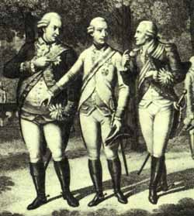
Reaction from Other Countries
Many other European nations disliked the spread of Revolution
-> especially Austria and Prussia who ally together.
Illustration depicting Prussian King Frederick William III,
Austrian Emperor Leopold II, and the Comte d’Artois, Louis XVI’s brother
Notes:
Other European rulers viewed events in France with dismay. They not only feared the possibility that the situation in France could undermine stability in Europe as a whole, but that the revolutionary fervor there could possibly even spread to their own countries. One result of this was the Declaration of Pillnitz, in which the monarchs of Austria and Prussia stated their willingness to intervene in France under certain circumstances—mainly to protect the French royal family. Most people in France saw the Declaration of Pillnitz as an affront to their nation’s sovereignty, and several clamored for the government to declare war on Austria, which they viewed as the primary threat.

Slide 6
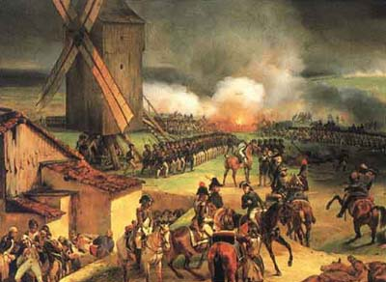
France at War
France was invaded by Austria and Prussian troops in April 1792. At first, the war went badly for France. French armies were disorganized and poorly led. Many army officers, who were nobles, had left France.
By August 1792, Austrian and Prussian armies were advancing on Paris.
Painting of the Battle of Valmy, 1792

Slide 7
At the same time in Paris… Attack on the Tuileries
The royal family was living under house arrest in the Tuileries Palace.
An angry mob (SANS-CULOTTES) got into the building on June 20, 1792, and found their way to the King.
The crowd shouted insults and was in an ugly mood.
The King remained calm and obediently put on the red cap of liberty (a symbol of revolution) at the mob's insistence.

Slide 8
Mob placing the red cap of liberty on the King's head at the Tuileries

Slide 9
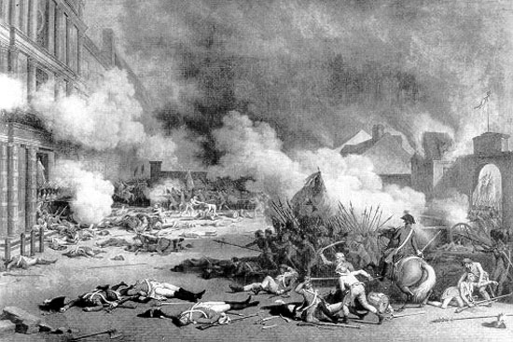
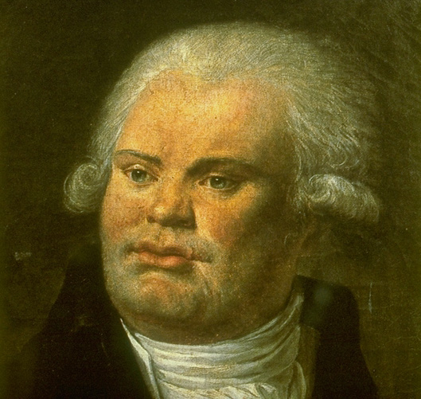
August 10, 1792, Radical revolutionaries lead by Danton took over Paris and marched on the Tuileries, where the king and his family lived.
The troops attacked the palace, killing many of the king’s Swiss guards.
August 10, 1792, attack on the Tuileries
The constitutional monarchy was over.

Slide 10
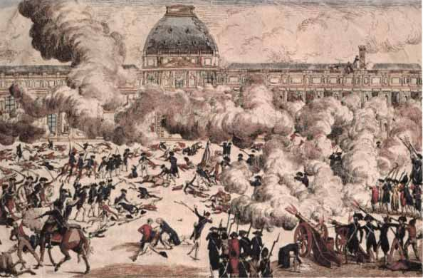
The king and queen fled to
the Legislative Assembly,
hoping for protection...
But the radicals also seized
control of the Assembly.
-> They removed the king
from office and voted
to imprison the royal family.
-> They then called for a
National Convention to write
a new constitution.

Slide 11
Four Phases (Periods) of the French Revolution
National Assembly (1789-1791)
Legislative Assembly (1791-1792)
Convention (1792-1795)
Directory (1795-1799)

Slide 12
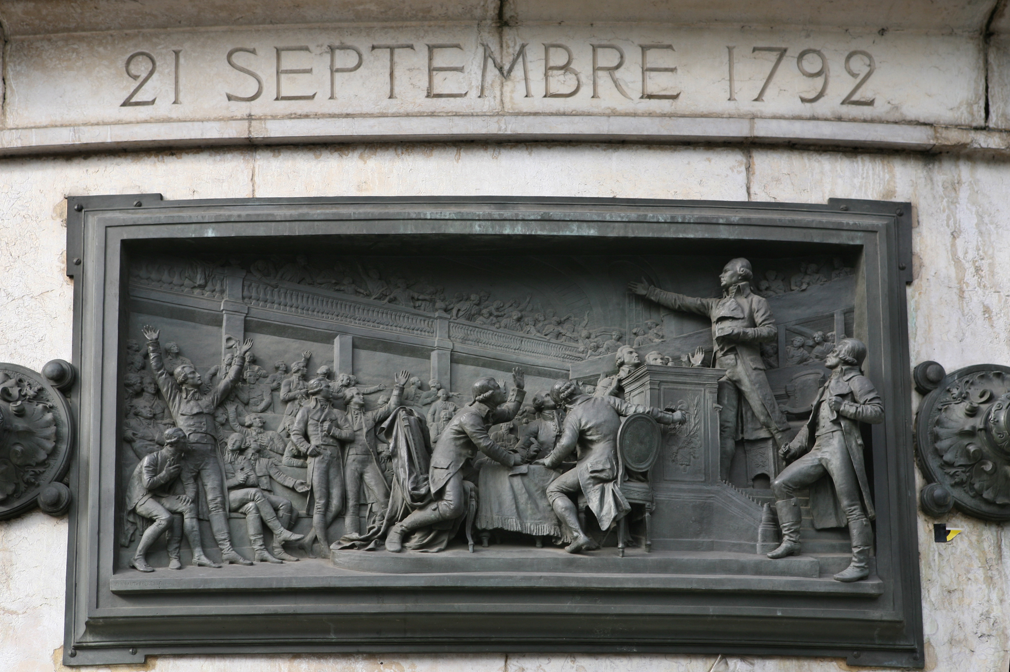
The National Convention (1792-1795)
First met on
September 21, 1792
Revolutionary Calendar
Factions:
-> Jacobins vs. Girondins
A Jacobin club
Notes:
The National Convention was the new legislative body that replaced the National Assembly. The first act of this new government was to officially remove the King from the French government. France was declared a republic. The National Convention also discarded the traditional Gregorian calendar in favor of a Revolutionary Calendar; the year 1792 was labeled as Year 1.
Two main factions dominated the National Convention. Jacobin clubs were radical political groups that had sprung up throughout France during the Revolution; initially, the Jacobins had total control of the National Convention. A split soon developed, however, between the Jacobins and the Girondins, who represented the provinces. The Girondins were soon expelled from the Jacobins because they were too moderate. The most radical Jacobins were called “The Mountain” because they sat in the highest seats of the hall where the National Convention met. All three groups agreed that Louis had committed treason, but only the Mountain demanded his execution.

Slide 13
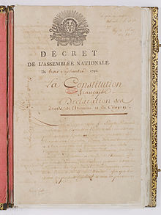
The National Convention voted
-> to abolish the monarchy
-> Make France a REPUBLIC
The Convention then had to decide what
to do with the king.
-> The radical Jacobins demanded that
Louis be tried for treason
-> The Girondists were more moderate

Slide 14
The OPPOSITION during the National Convention
-> Faced domestic opposition
Girondists were moderates who represented the rich middle class of the provinces
Jacobins (led by Marat, Danton, and Robespierre) represented workers
-> Faced opposition from abroad
Austria, England, Holland, Prussia, Sardinia, and Spain formed a Coalition invading France

Slide 15
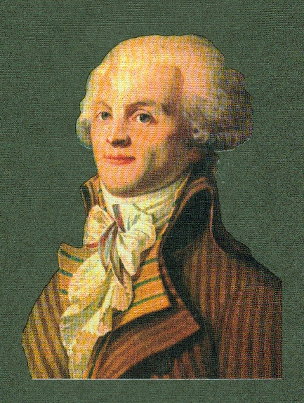
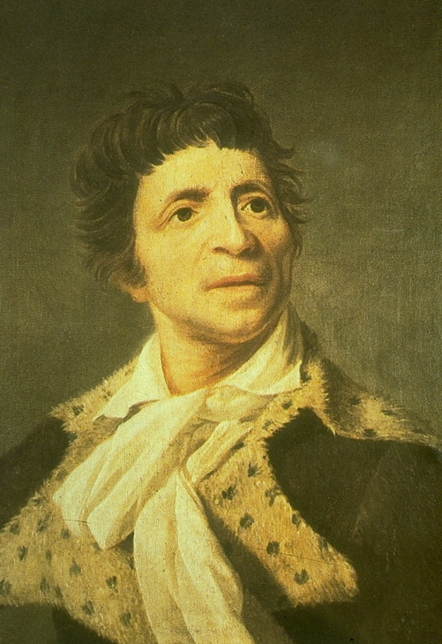
Jacobins Leaders
Georges Danton
Jean-Paul Marat
Robespierre - Lawyer
Most controversial figure of
the French Revolution
Notes:
One of the most prominent Jacobin leaders was Jean-Paul Marat, who had been an early advocate of abolishing the monarchy. He advocated the elimination of any of the “enemies of the Revolution” and thus supported the September 1792 massacres, in which 1200 political prisoners in the jails of Paris were killed by Jacobin-supported mobs. One of the most radical members of the National Convention, Marat strongly condemned the Girondins for being too moderate; the Girondins in turn saw him as an increasingly dangerous demagogue. On July 13, 1793, Marat was stabbed to death in his bathtub by Charlotte Corday, a young Girondin.
Another important Jacobin leader was Georges Danton, a member of the Commune of Paris who had helped organize the attack on the Tuileries and the overthrow of the monarchy. In the new republic, he became minister of justice. A member of the National Convention, he dominated the first Committee of Public Safety.

