Slide 1
Lesson 12 Reign of terror - Directory

Slide 2
Reign of Terror: September 5, 1793-July 27, 1794
After the death of Louis XVI, the government became more and more radical. Despite military successes, the Convention continued to face problems domestically.
->Danton and his Jacobin political party came to
dominate French politics. The «sans-culottes» gave
a «coup-d´Etat» against the Girondins in June 1793.
-> Harsh laws made it possible to arrest and kill
almost anyone just by accusing them of speaking
against the revolution.
-> Nobles, clergy, food speculators, Girondists, and even Jacobins and commoners were killed in large number.

Slide 3
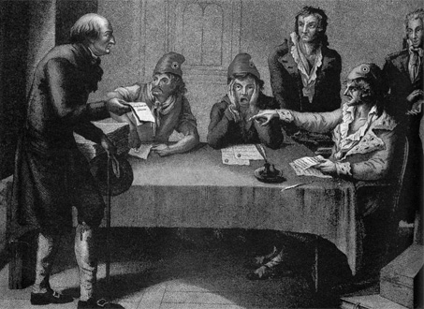
To respect the harsh laws ->The Committee of Public Safety
Created in 1793 to
-> Cease an internal rebellion
-> Given dictatorial power
->Headed by Danton (and later Robespierre)
A citizen petitions the Committee of Public Safety
Notes:
After the execution of the king, the National Convention declared war on Britain and Holland, who had joined the First Coalition against France (Spain later joined the Coalition as well). Meanwhile in the spring of 1793, a pro-monarchy revolt broke out in the region of La Vendee in the French countryside. In order to deal with the crisis, the National Convention created a Committee of Public Safety, which was given broad powers in order to cease the uprising. Initially headed by Danton, the Committee ended up ruling with almost dictatorial power for about a year. This development ultimately proved fatal for the Revolution.
The duties of the Committee of Public Safety seemed mundane enough at first. The Committee was charged with the tasks of drafting conscriptees into the French army via the levee en masse. The Committee soon went beyond this, however, and rapidly expanded its authority in order to safeguard the revolution. Its leading members were Danton, Marat, and Robespierre. Initially, Danton dominated the committee; however, he began to advocate more conciliatory policies and by the summer of 1793, he had been replaced by Robespierre and the more radical Jacobins. Robespierre would transform the committee into an instrument by which he could rid himself of rivals and enemies. He used the power of the Committee to more or less seize control of the National Convention, which he then induced to give the committee even more power. By this point, the Committee was essentially a dictatorship.

Slide 4
Those accused of treason were tried by the Committee’s Revolutionary Tribunal
-> Approximately 30,000
people died on the guillotine
-> Guillotine =
“National Razor”
-> Ruled France for nearly
a year

Slide 5
Why kill so many people?
The Terror was designed to :
-> fight the enemies of the revolution,
-> prevent counter-revolution from gaining ground.
Most of the people rounded up were not aristocrats, but ordinary people.
-> A man (and his family) might go to the guillotine for saying something critical of the revolutionary government.

Slide 6
Example of Law of Suspects, 1793
Watch Committees around the
nation were encouraged to
arrest "suspected persons, ...
those who, either by their
conduct or their relationships,
by their remarks or by their
writing, are shown to be
partisans of tyranny and
federalism and enemies of liberty"

Slide 7
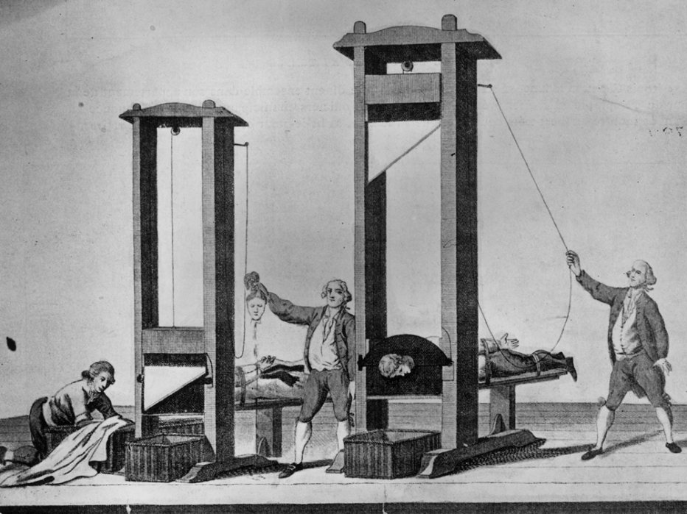
Suspension of Civil Liberties
The Convention ordered that :
"if material or moral proof exists,
independently of the evidence of
witnesses, the latter will not be heard,
unless this formality should appear necessary, either to discover accomplices or for other important reasons concerning the public interest."
The promises of the Declaration of the Rights of Man were forgotten.

Slide 8
The guillotine = the new instrument of egalitarian justice.
-> Public executions were considered educational.
-> Women were encouraged to sit and knit during trials and executions.
The Revolutionary Tribunal ordered the execution of 2,400 people in Paris by July 1794. Across France 30,000 people lost their lives.

Slide 9
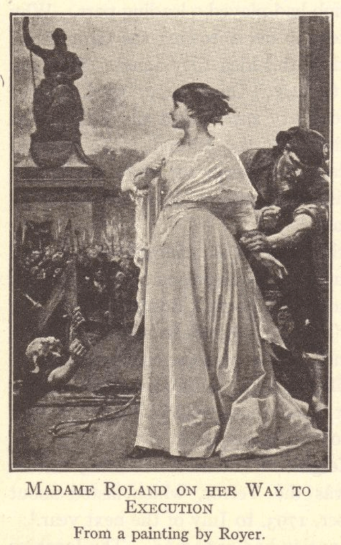
Guillotine Including
Innovative thinkers
like
Olympe de
Gouges and
Madame Jeanne Roland
Olympe de Gouges

Slide 10
Members of the Girondist political party tried to end the Reign of Terror initiated by the Jacobin political party
This opposition to the
Committee of Public
Safety caused many
Girondists to be tried
and executed for
treason

Slide 11
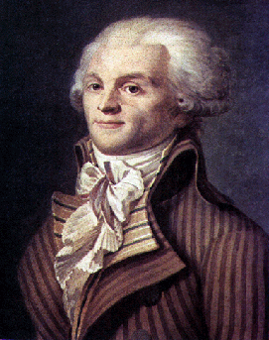
Who was behind the terror?
Terror was the order of the day.
Softness to traitors will destroy us all.

Slide 12
Maximilien Robespierre = the mastermind of the Reign of Terror.
He was the leader of :
-> the Committee of Public Safety (after Danton)
-> the executive committee of the National
Convention
-> the most powerful
man in France.
The old maxim
“The end justifies the means" describes Robespierre's policy well.
Terror is nothing
other than justice, prompt, severe, inflexible

Slide 13
When Robespierre called for
a new purge in 1794, He seemed to threaten the other members of the Committee of Public Safety.
Danton (Jacobins) rose in the Convention …
What did he said?

Slide 14
Even the radical Jacobins, the supporters of Robespierre, come to feel that the Terror must be stopped.
Georges Danton rose in the Convention
calling for an end to the Terror
What happened to Danton?
He was it’s next victim on April, 1794
It is time to tell the whole truth. One man alone is paralyzing the will of the Convention. And that man is Robespierre.

Slide 15
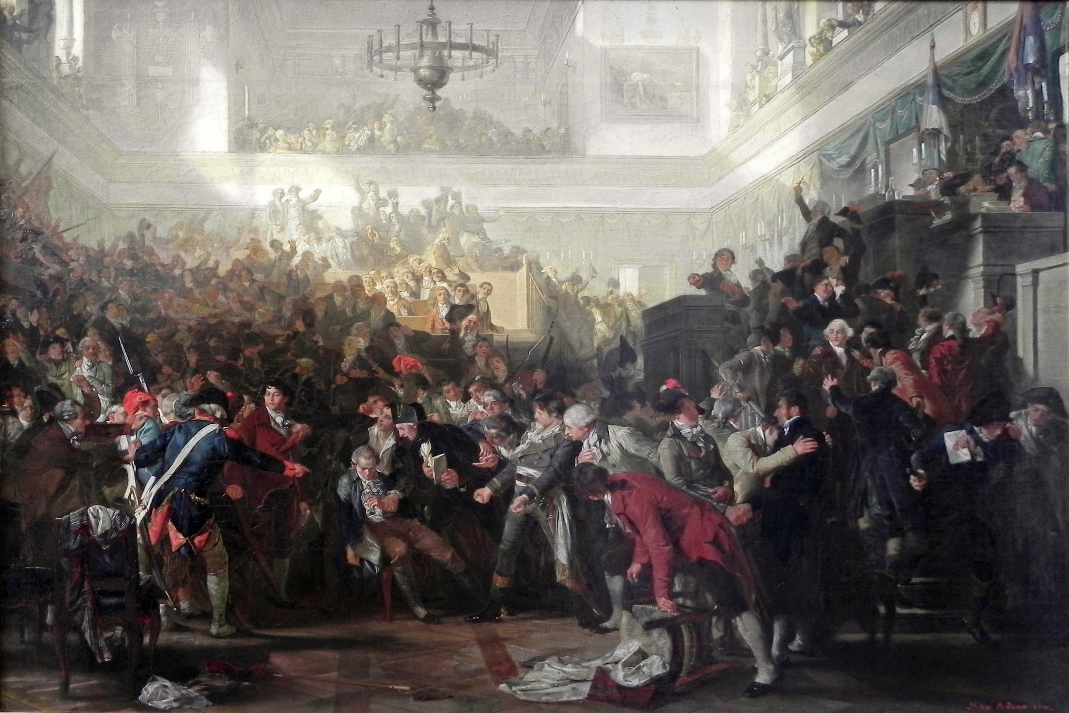
Robespierre became the leader of the Committee of Public Safety
-> He continued the
executions
-> The Convention blamed
him for the Reign of Terror
-> He threatened to
execute more members of
government, but didn’t
specify who….

Slide 16
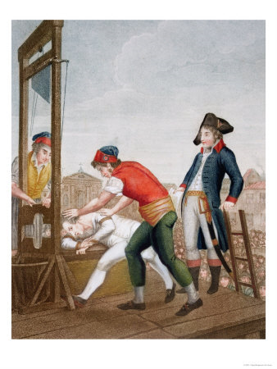
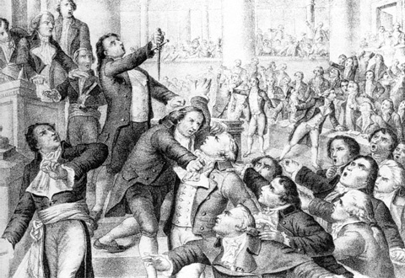
Thermidorean Reaction/ Coup-d’Etat July 27, 1794 – ended the Reign of Terror
Convention removed Robespierre ppwer and sent Robespierre and other members of the Committee of Public Safety to the guillotine
-> Robespierre was
guillotined on July 28, 1794
-> Committee of Public
Safety was dismantled
-> The Jacobin clubs was
disbanded

Slide 17
Constitution of the Year III of the Republic (1795)
People had grown tired of the instability and bloodshed of the revolution and were ready for something more moderate.
The foreign invaders vanquished The Reign of Terror at an end
+
=
The Convention was finally able to inaugurate the new constitution.

Slide 18
Reforms Passed by the Convention
Adopted the metric system
Established a nationwide system of public education
Ended slavery in France’s colonies
Dealt the final blow to feudalism by abolishing primogeniture (the system whereby the oldest son inherited all of his father’s estate)
Ended debt imprisonment
Drew up a comprehensive system of laws

Slide 19
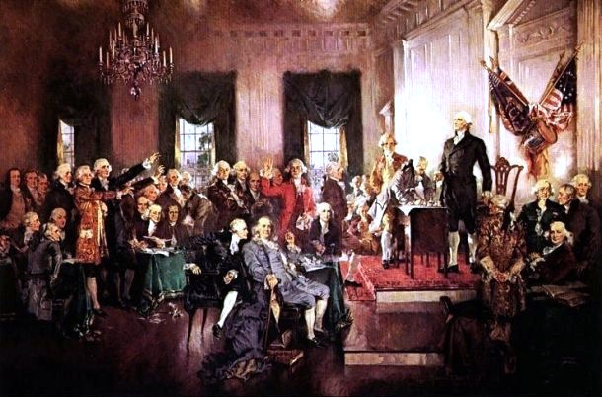
The Directory (1795-1799)
The Constitution of 1795 established a new government known as the Directory.
The republic was gone.
France´s moderate middle
class had gained control of
the country.
It was far more
conservative than the
Jacobin republic had been.
It was also ineffectual.

Slide 20
Government under the Directory
Executive
5 directors appointed by the Legislature to try to avoid dictatorships and to stop the violence and executions.
Legislature
Lower house (500 members) proposed laws
2/3 of the Legislature would initially be filled by members of the Convention
Qualifications
Girondists (middle-class party) had defeated the Jacobins (working- and peasant-class party)
Upper house (250 members) voted on these laws
Girondists’ constitution stated that suffrage (the right to vote), as well as the right to hold office, were limited to property owners

Slide 21
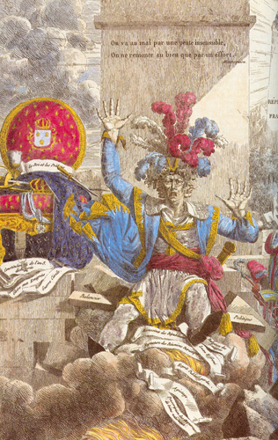
The Directory - Would it worked?
Cartoon depicting the errors and bad judgment of the Directory
Notes:
The Directory’s tenure was marked by scandal, financial troubles, and political strife. It promoted middle class interests, which irritated the working poor. Combined with runaway inflation and food shortages, the people of Paris rebelled once again. The Directory had to call in the army to put down the riots. One such riot in 1795 was ended by the intervention of the army under the leadership of Napoleon Bonaparte. As a reward for his actions, Napoleon was given command of French forces fighting the Austrians in Italy.

Slide 22
Problems…
The Directory suffered from corruption and poor administration -> Financial crisis
Promoted middle class interests
The people of France grew poorer, had food shortages and more frustrated with their government.
Despite, or perhaps because of, these struggles, the French developed a strong feeling of nationalism – they were proud of their country and devoted to it.
National pride was fueled by military successes.

Slide 23
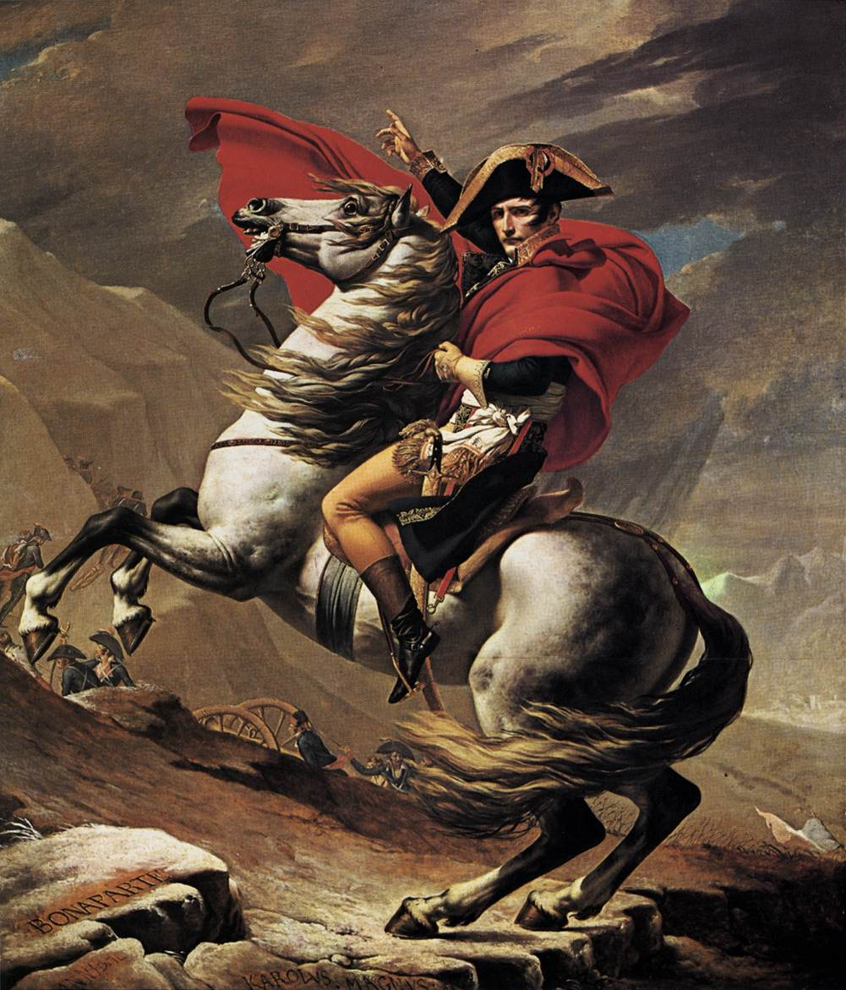
The Directory proved to be ineffective and weak :
-> Supporters of the monarchy wanted
to restore the Borbons.
-> Radical revolutionaries wanted to
regain control.
Something else was coming…

Slide 24
Four Phases (Periods) of the French Revolution
National Assembly (1789-1791)
Legislative Assembly (1791-1792)
Convention (1792-1795)
Directory (1795-1799)

Slide 25
Review Questions
1. What Paris building was stormed on July 14, 1789?
2. What human rights were established in France by the Declaration of the Rights of Man?
3. How did Olympe de Gouges fight for women’s rights?
4. What were émigrés, and why did French revolutionaries view them as a threat?
5. Name and describe the two political parties that competed for power in revolutionary France.
6. What was the Committee of Public Safety?
7. Describe the Reign of Terror and explain how it eventually came to an end.
8. Were the “excesses” of the French Revolution justified? Why or why not?
9. Looking back at the first half of 1789, could the French Revolution have been avoided? If so, how?

