Slide 1
Lesson 2 : Kings and Queen

Slide 2
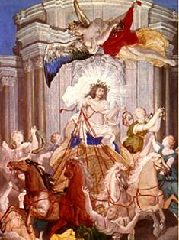
Government under the Old Regime: The Divine Right of Kings
Monarch ruled by divine right
God put the world in motion
God put some people in positions of power
Power is given by God
No one can question God
No one can question someone put in power by God
Questioning the monarchy was blasphemy because it meant questioning God

Slide 3
What the King Did…
Appointed the Intendants, the “petty tyrants” who governed France’s 30 districts
Made decisions regarding war and peace
Made all laws
Could imprison anyone at any time for any reason (blank warrants of arrest were called lettres de cachet)
Controlled justice by appointing judges
Controlled the military
Levied all taxes and decided how to spend the money
Appointed the people who would collect his taxes and carry out his laws

Slide 4
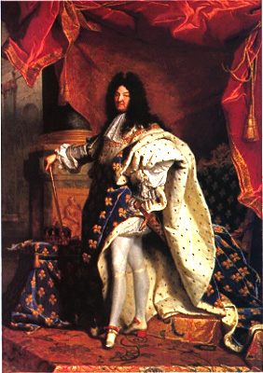
LOUIS XIV 1638-1715
THE SUN KING

Slide 5
Video
http://www.biography.com/people/louis-xiv-9386885

Slide 6
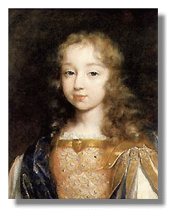
He became King at age 4 but did not rule until he was 23
Normally, Kings appointed Prime Ministers, to run the country.
At 23, Louis decided he would rule the country himself.

Slide 7
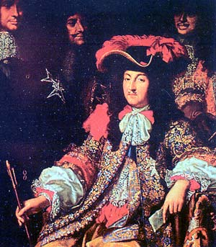
He was a firm believer in the the DIVINE RIGHT OF KINGS He was a CATHOLIC and supported JAMES II in England
Most Kings in France had problems with the Nobility trying to challenge the kings power
Louis had an idea on how to change that…

Slide 8
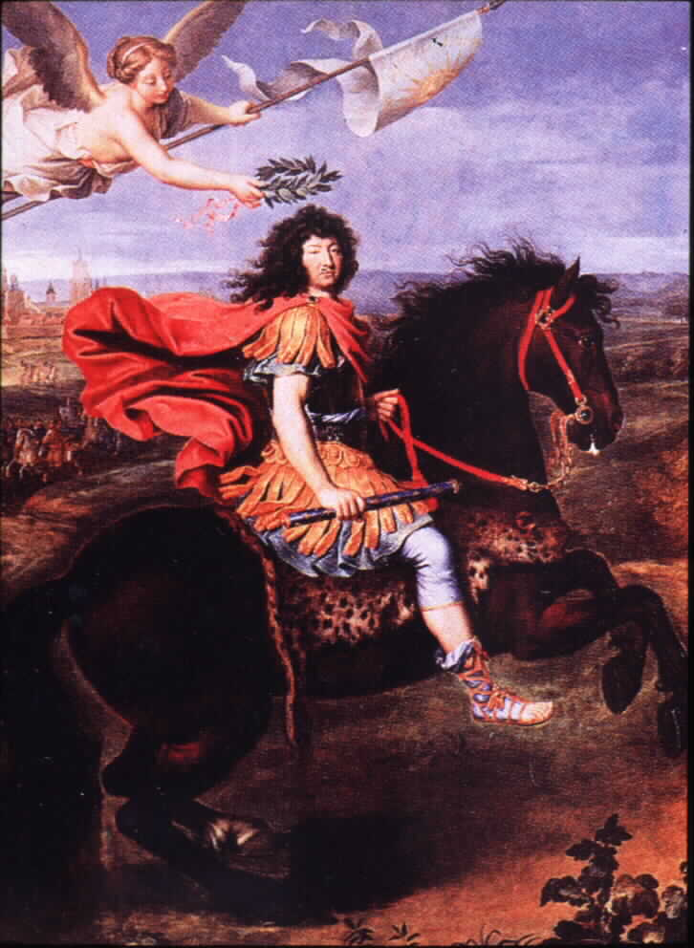
Normally, most important positions in government were bought by Nobles. This was one way for the King to raise money. Nobles generally controlled the government
Louis appointed skilled middle class people to government, and earned their loyalty. Nobles influence was diminished

Slide 9
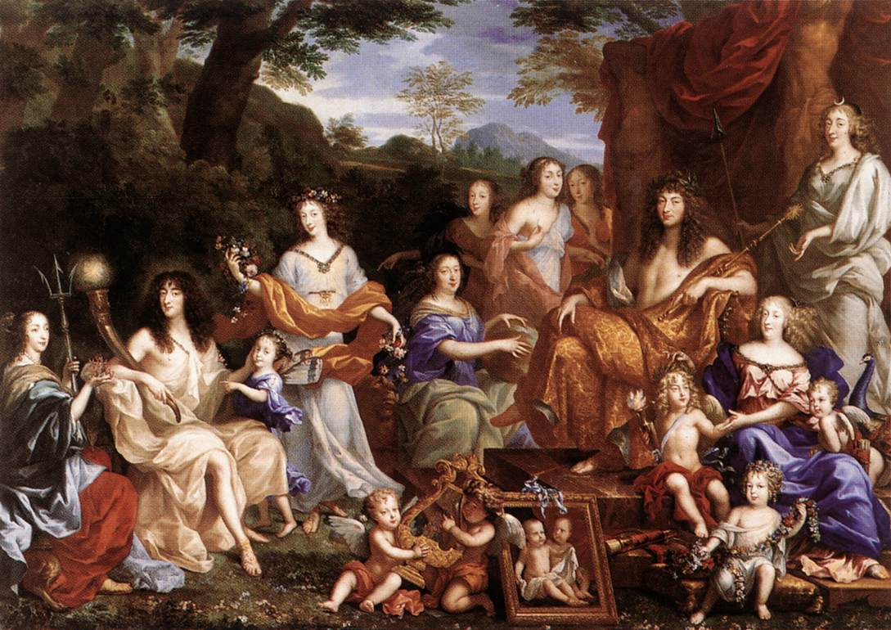
→ Without government jobs, Nobles depended on the King’s generosity for income
Louis kept the Nobles dependent on him by only giving money to those who were totally loyal to him and served him at the palace

Slide 10
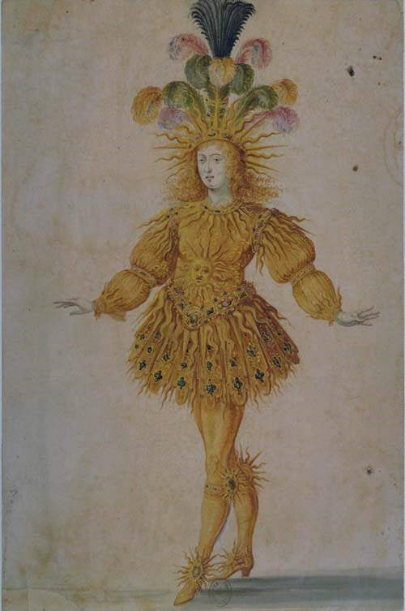
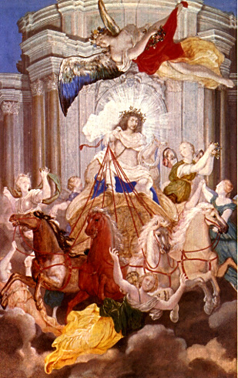
He was called the Sun King because he saw himself as the centre of the France
”L’Etat C’est Moi”

Slide 11
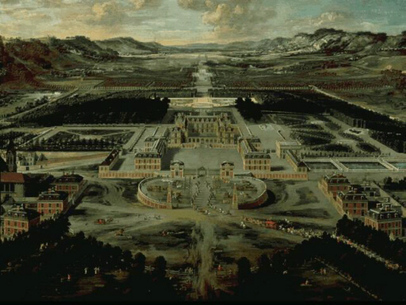
Louis built probably the most magnificent palace ever built in Europe--Versailles. It cost around 1 billion dollar and over 35, 000 people working for decades to complete it. He was still adding to it at his death

Slide 12
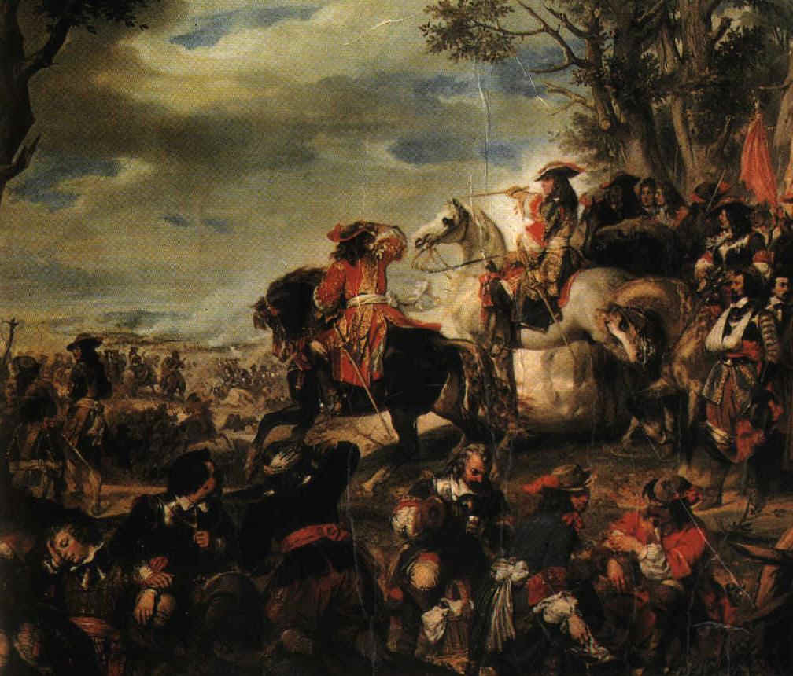
His lavish spending and love of war--especially against Protestants--brought France to the brink of Bankruptcy by the time he died

Slide 13
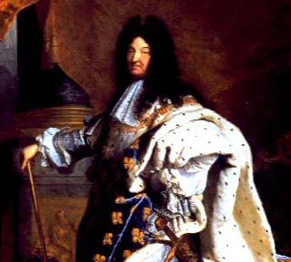
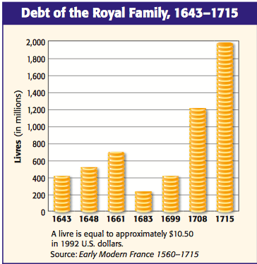
Louis XIV do…
Reduced the power of the nobility
Fought four wars
Greatly increased France’s national debt
Notes:
France before the Revolution is often referred to as the ancien régime; during this period of more than 130 years (spanning both the 17th and 18th centuries), the country had just two rulers. The first, King Louis XIV, had a powerful impact on France during his long reign (1643–1715) and is considered by many as the epitome of an absolutist ruler. He centralized power in himself at the expense of the nobility, removing them from positions as governors and ministers and relegating them to the role of courtiers at the royal palace at Versailles.
Louis implemented policies that led France to emerge as the dominant power in continental Europe. He increased the nation’s standing army and fought four wars between 1667 and 1713. These wars added to France’s international standing and prestige, but left the country deeply in debt. Louis increased this debt by undertaking both public construction (such as new networks of roads and canals) and royal building projects, including the grand palace at Versailles. He also spent huge sums maintaining a lavish lifestyle for the royal court at Versailles. He attempted to offset France’s mounting deficits by increasing taxes on the peasants, but by the time of his death the country still remained heavily in debt.

Slide 14
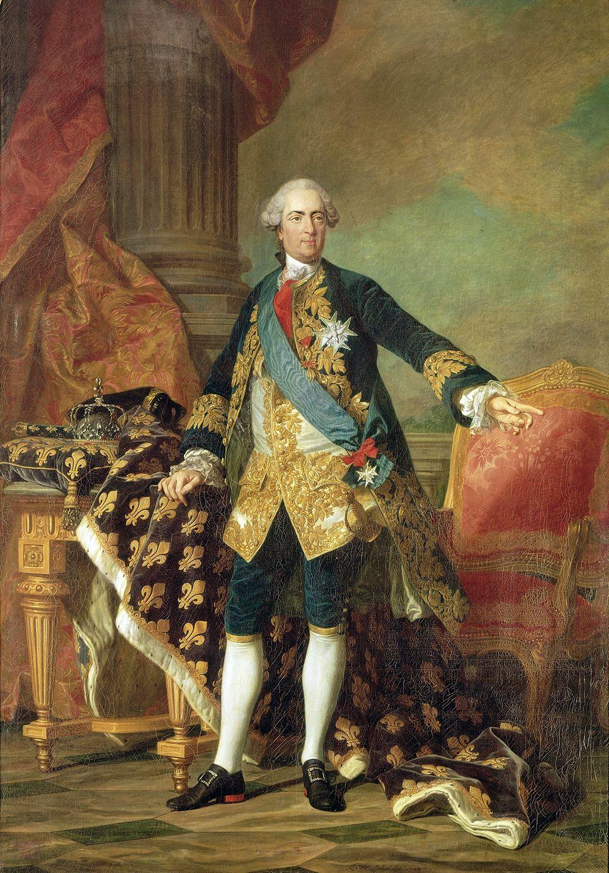
LOUIS XV 1710-1774

Slide 15
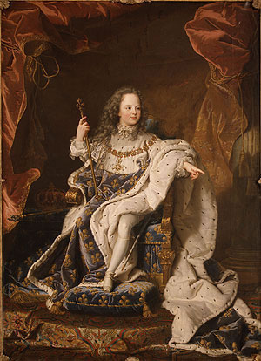
He became King at age 5 in 1715 The child king Louis XV did not rule—the government was controlled by Cardinal Fleury and the Duke of Orleans, a cousin of the young king.

Slide 16
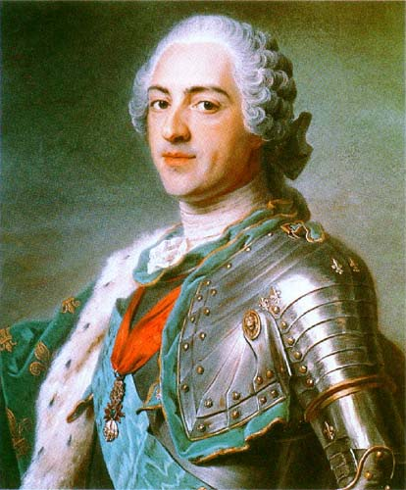
As Louis XV came of age, he turned out to be a spoiled, handsome, pleasure loving man. He would not be the king his grandfather, Louis XIV was.

Slide 17
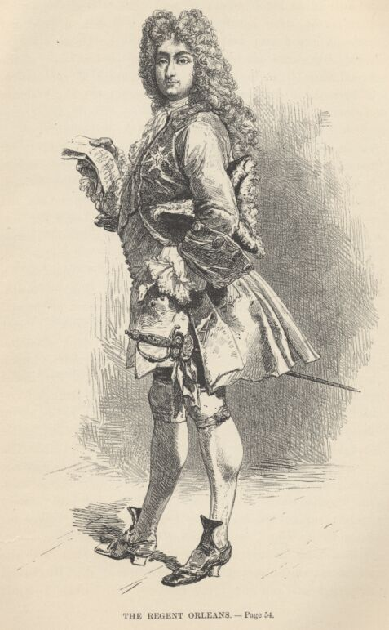
Louis XV
Had regents until 1726
Seen as lazy and frivolous
Spent $ on court life and wars, increased the national debt
Attempts at tax reform were squashed by nobles
Renewed the authority of the parlements…mistake??

Slide 18
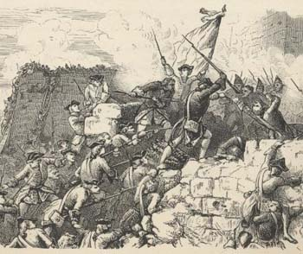
The Seven Years’ War
War fought in Europe, India, North America
France ends up losing some of its colonial possessions
Increases French national debt
Notes:
Louis XV (1715–1774) proved to be incapable of dealing with France’s financial problems and increased the debt by involving France in the Seven Years’ War. The war pitted the British and Prussians on one side against the French, Austrians, and Russians on the other. Fighting took place not just in Europe, but also in India and in North America, where the war was known as the French and Indian War because France allied with Native Americans against the British and American colonists. Though the war ended up a stalemate in Europe, France suffered defeats to the British in North America and in India; as a result, it was forced to cede some of its colonial possessions. Much of the burden of paying for the war fell on the peasantry.

Slide 19
LOUIS XVI 1754-1793

Slide 20
Born the oldest of Eight Children.
At 11 , after his father died he became heir to the throne which his grandfather poorly prepared him for.

Slide 21
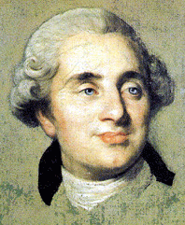
Louis XVI was an awkward, clumsy man who had a good heart but was unable to relate to people on a personal level.
He often appeared unfeeling and gruff.
He was insecure and seems to have disliked being King of France.

Slide 22
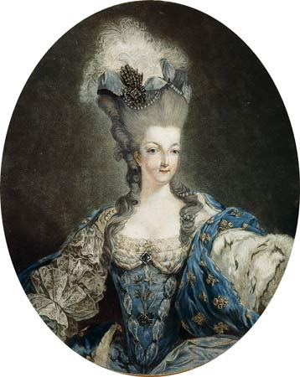
At the age of 15, he married Marie Antoinette of Austria.
Many people already did not like the queen coming from Austria but when she couldn’t produce a child they were outraged.

Slide 23
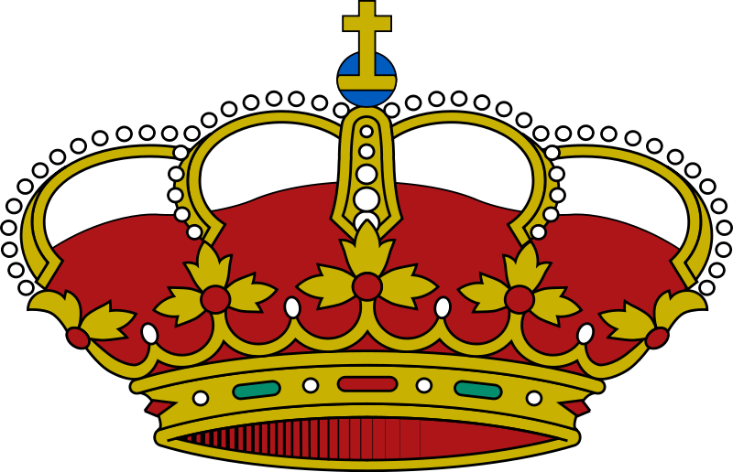
Absolute monarch
Took the throne at the age of 20 in 1774 (grandfather died)
When he took the throne his government was deeply in dept from past wars.
Many felt that he was not prepared to rule and was not firm enough.

Slide 24
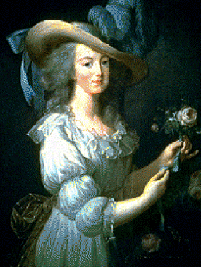
Marie Antoinette
Marie Antoinette, in her early years as Queen, was flighty and irresponsible. She spent huge amounts on clothes, buying a new dress nearly every other day.
Being Austrian, she was terribly unpopular in France and had few friends.

Slide 25
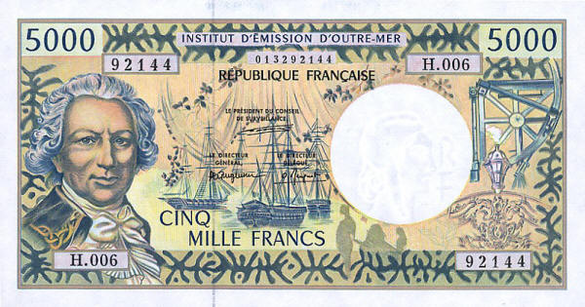
Kings decreasing power
Many people felt that Louis and Marie Antoinette spent lavishly.
Maries expensive hairstyles and party’s at Versailles added to France’s debt.
This also added to the peoples doubt and Louis drift from power.
To be continued…

Slide 26
Versailles - 6 may 1682

Slide 27
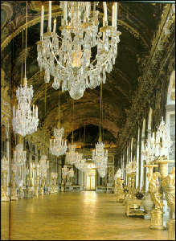
The French Royalty
The King and Queen of France lived in luxury and splendor at the magnificent Palace of Versailles outside of Paris.
Hall of Mirrors

Slide 28
Video
Versaille :
http://www.biography.com/people/louis-xiv-9386885/videos/the-palace-of-versailles-132219459795
From outside https://www.youtube.com/watch?v=aIV8ZuK_hbA
MTV : https://www.youtube.com/watch?v=V_Y_-1mAKLk

