Slide 1
Lesson 5 – Causes of the French Revolution

Slide 2
Why would a revolution occur?
French Revolution
(Causes)
Gap between Estates
& responsibilities
Poor leadership
Enlightenment Ideas
Economic Problems

Slide 3
Gap between estates and responsibilities
Although people were starving and the country was broke, the royal family flaunted their wealth and uncaring.
Louis XVI lavished money on himself and residences like Versailles
Queen Marie Antoinette was seen as a wasteful spender

Slide 4
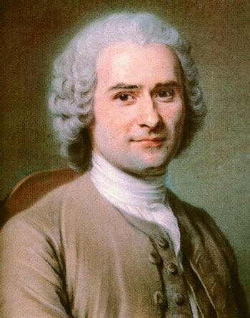
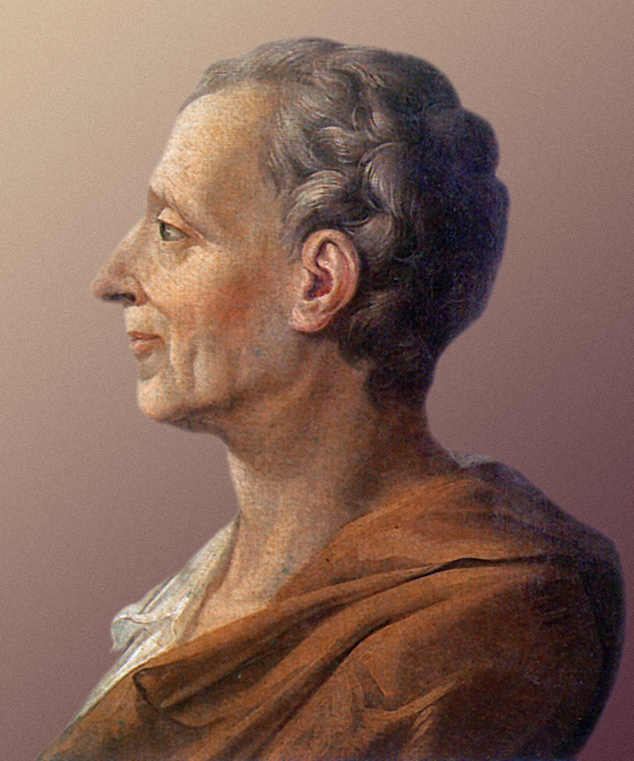
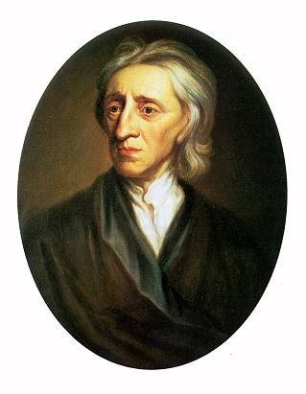
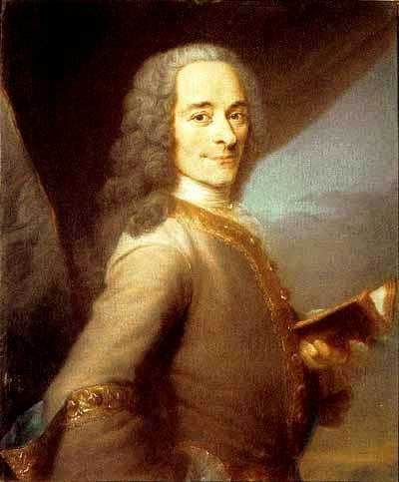
Enlightenment ideas
- Rousseau, Montesquieu, Locke, Hobbes et Voltaire
- Ideas of liberty and equality from the American Revolution (note: Constitution was signed 2 years before in 1787)

Slide 5
Economics problems - Financial Crisis
Finance Minister
Jacques Necker
Notes:
The expenditures France made on the American Revolution—along with the huge sums the king spent to maintain his lavish lifestyle—worsened its already precarious financial situation, and by the late 1780s the government lay close to bankruptcy. King Louis XVI’s Finance Minister, Swiss banker Jacques Necker, knew that the poor had already been taxed as much as possible and therefore a new source of revenue had to be found. Necker proposed levying a tax on all property: this essentially meant that the First and Second Estates—the Church and the nobles—would now have to pay taxes. Needless to say, neither of these groups supported this plan. The aristocracy, who saw their exemption from taxation as a birthright, refused to even discuss the issue. The Church, which had grown wealthy on tithes and property holdings, also rejected the idea of having to pay taxes on its lands. Since the First and Second Estates had balked at his plan, Necker urged the king to call a meeting of the Estates General in order to get the property tax implemented.

Slide 6
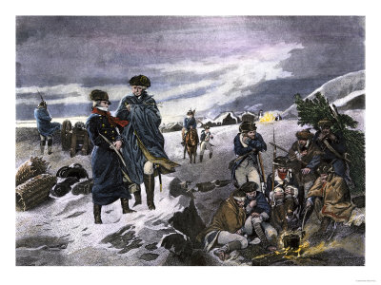
The Growing Crisis
French support of the American Revolution alone nearly doubled the government’s debt.
Marquis de Lafayette and George Washington

Slide 7
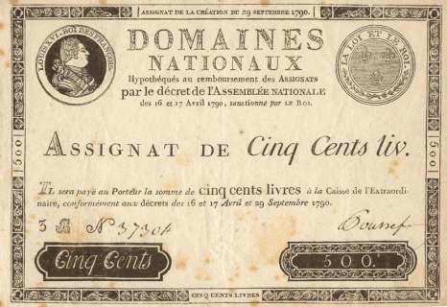
The most serious economic problem during the 1770s and 1780s was the huge debt it owed to bankers.
The government had borrowed large amounts of money to pay for the wars of Louis XIV. Louis XV and Louis XVI continued to borrow money to support the court at Versailles and to fight wars to maintain French power in Europe and over-seas.

Slide 8
Deficit spending – a government spending more money than it takes in from tax revenues
Privileged classes would not submit to being taxed
Families were falling apart because parents were abandoning children they couldn’t feed
Improvements in industry in Britain put workers in France out of business
Bourgeoisie often managed to gather wealth
But were upset that they paid taxes while nobles did not

Slide 9
Louis XV and his grandson spend France’s money!!!
Build Versailles
Funded American Revolution
In deep debt from failed 7 Years War against Britain
No national budget for King to follow

Slide 10
Long-term Causes of the French Revolution
Everything previously discussed
Absolutism
Unjust socio-political system (Old Regime)
Also
System of mercantilism which restricted trade
Influence of other successful revolutions
Poor harvests which left peasant farmers with little money for taxes
Influence of Enlightenment philosophers
England’s Glorious Revolution (1688-1689)
American Revolution (1775-1783)

Slide 11
Short-term Causes of the French Revolution
Bankruptcy
Caused by deficit spending
Financial ministers (Turgot, Necker, Calonne) proposed changes
Great Fear
Worst famine in memory
Estates-General
Louis XVI had no choice but to call for a meeting of the Estates-General to find a solution to the bankruptcy problem
Had not met since 1614
But these were rejected
Assembly of Notables voted down taxation for the nobility in 1787
Hungry, impoverished peasants feared that nobles at Estates-General were seeking greater privileges
Attacks on nobles occurred throughout the country in 1789
All three estates
Set in motion a series of events which resulted in the abolition of the monarchy and a completely new socio-political system for France

Slide 12
King Louis XVI
This king was weak
He had so little control, he called for the French congress to fix some problems

