Slide 1
Lesson 6 : General Estate

Slide 2
Video (43 secondes to 3 mins)
https://www.youtube.com/watch?v=lTTvKwCylFY

Slide 3
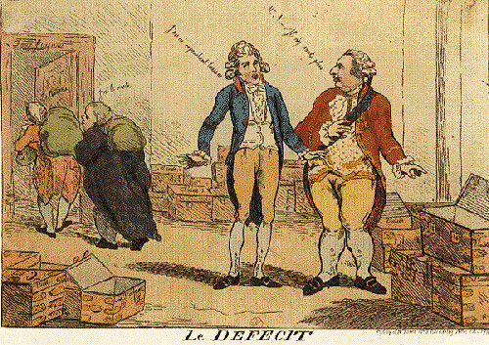
Where is the Money?
In this cartoon from the time, Louis is looking at the chests and asks
“Where is the tax money?“
The financial minister, Necker, looks on and says “
The money was there last time I looked."
The nobles and clergy are sneaking out the door carrying sacks of money, saying "We have it."

Slide 4
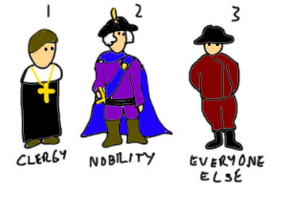
King Louis XVI – no choice
Called for a meeting of the Estates-General* to find a solution to the bankruptcy problem
Had not met since 1614 (175 years)
Had Three Estates: Clergy, Nobles, Everyone Else.
*= a form of parliament that
had to be called by the king

Slide 5
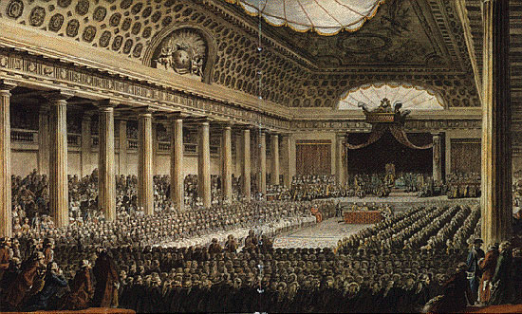
The meeting of the Estates General May 5, 1789

Slide 6
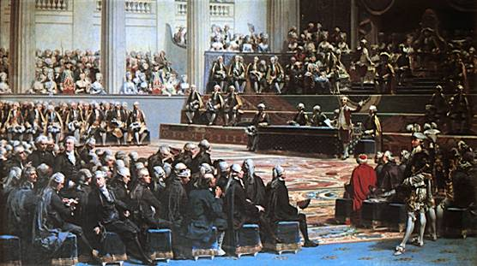
Meeting of the Estates-General: May 5, 1789
Voting was conducted by estate
First Estate + Second Estate VS Third Estate
Representatives from the Third Estate
demanded that voting be by population
(by head and not order)
This would give the Third Estate a great
advantage
Deadlock resulted

Slide 7
First Estate = 1 Vote or 130,000 Votes
Third Estate = 1 Vote or 25,000,000 Votes
Second Estate = 1 Vote or 110,000 Votes

Slide 8
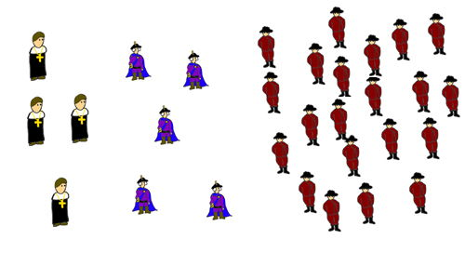
Each Estate would vote to determine its own opinion and then have 1 vote in the Estates General
The first two Estates always voted against the 3rd
1 + 1 > 1

Slide 9
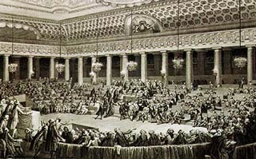
The Estates-General
After Louis XVI called the Estates
General in 1789, the 3rd Estate argued for
change for 6 weeks, but was ignored
The delegates of the 3rd Estate
walked out and started a new government
called the National Assembly.

Slide 10
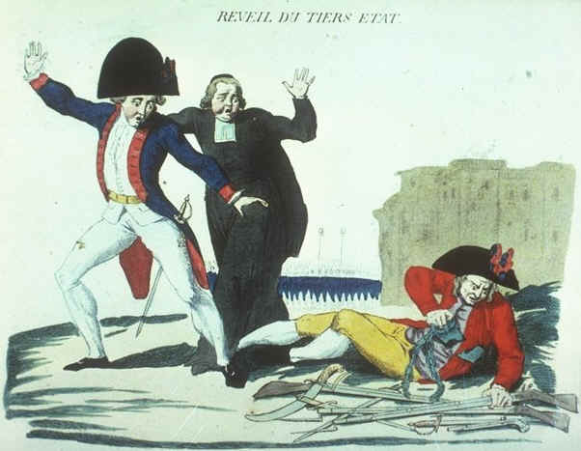
The National Assembly
The Third Estate took action and established its own government
On June 17, 1789, the National Assembly was formed
Notes:
After weeks of frustrating debate over voting, the representatives of the Third Estate declared themselves the “National Assembly” and claimed that they were France’s true representative body. They invited members of the other estates to join them, and some members of the clergy and aristocracy did so. The National Assembly was inspired by the influential Abbé Sieyes, who had earlier published a pamphlet that proclaimed the Third Estate and the nation were one.

Slide 11
This new government was formed in a Tennis Court.
They promised not to disband until they had written a constitution
→ The Tennis Court Oath
The delegates agreed and
all but one of the 578 delegates signed it on June 20, 1789

Slide 12
Tennis Court Oath
The Third Estate declared itself to be the National Assembly.
Louis XVI responded by locking the Third Estate out of the meeting.
The Third Estate relocated to a nearby tennis court where its members vowed to stay together and create a written constitution for France.
On June 23, 1789, Louis XVI relented. He ordered the three estates to meet together as the National Assembly and vote, by population, on a constitution for France.

