Slide 1
Lesson 8 :
Women and Clergy

Slide 2
Timeline 1789
June 23
Louis XVI ordered a meeting as a National Assembly
Vote by population +
new constitution
July 20 to August 4 1789
May 5
Estate General
----------------------------------------------------------------------------------------------------------------------------------------------------------------->
July 14, 1789
Stormed of the Bastille
June 20
National Assembly
Tennis Court Oath
August 4
National Assembly -> End of Feudal Privileges
August 28
Declaration of the Man rights

Slide 3
Lower classes still unsatisfied… Why?

Slide 4
Where is the food?
Rumors had spread that Versailles was holding all of the grain

Slide 5
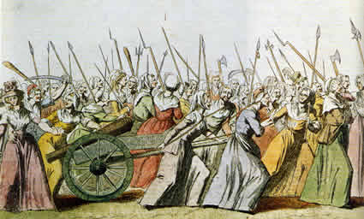
Women’s March to Versailles October 4, 1789
-> demanding bread for their families
They arrived, soaking wet and they demanded to see :
"the Baker," "the Baker's wife," and "the Baker's boy".
->The King met with some of the women and agreed to distribute all the bread in Versailles to the crowd.

Slide 6
Consequences for the Royal Family?
Notes:
Though the lower classes undoubtedly endorsed the ideas expressed in the Declaration, the issuing of the document still did not satisfy them—largely because the king refused to accept either the Declaration or the National Assembly’s abolition of feudalism. Louis had consequently abandoned Paris and moved to the royal Palace of Versailles in order to avoid the turmoil in the city. Meanwhile by October, food shortages had become critical again. On October 5th, a starving crowd of thousands of women marched on Versailles in order to get the king to accept the National Assembly’s measures. By the time they reached the royal palace, the march had become a mob. The National Guard attempted to maintain order, but the mob attacked the palace. Only when the king agreed to return to Paris was some semblance of order restored. Once back in the capital, the king and his family were essentially imprisoned in the Tuileries Palace.

Slide 7
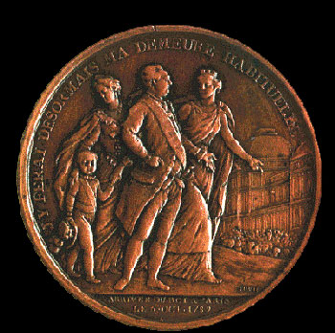
Suspicion
The king and the queen were plotting against the National Assembly.
-> They stormed the palace, trapping the royal family.
-> Louis XVI and his family are forced to return with them to Paris, where they could be watched.
-> To prevent violence, the king agreed.

Slide 8
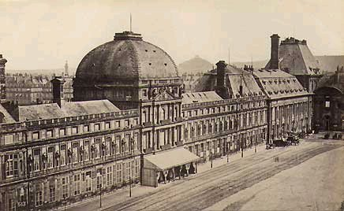
Goodbye, Versailles! Hello, Tuileries!
Royal family spent next several years in the Tuileries Palace as virtual prisoners

Slide 9
The king rode on horseback, escorted by a cheering crowd.
He wore the tri-colore, the red, white, and blue ribbon that the revolutionaries had adopted as their symbol.
-> People proved that they were directing events in France.

Slide 10
Declaration of the rights of Man and the citizen = Everyone was given the title of citizen
-> All feudal dues and tithes
were eradicated
->All special privileges of the
First and Second Estates
were abolished
And Women? Clergy?

Slide 11
The Journalist
Olympe de Gouges
argued in her
Declaration of the Rights
of Woman (1791)
-> women are equal
citizens and should
benefit from
governmental reforms
just as men did.
Jeanne Roland
= leader in the women’s rights movement, and
was able to heavily influence her husband (a government official).

Slide 12
Women did gain some rights during the French Revolution ☺ but… ☹
…These were designed for purposes other than liberating women.
1) Women could inherit property
-> only because doing so weakened feudalism and reduced wealth among the upper classes.
2) Divorce became easier, but only to weaken the Church’s control over marriage.

Slide 13
The Civil Constitution of the Clergy (July 12, 1790)
The National Assembly resolved the immediate financial crisis by:
Seizing, divided, and sold to peasants church lands
Putting the church under the control of the State with The Civil Constitution of the Clergy
-> required that Church officials be elected by the people, with salaries paid by the government
->2/3 of Church officials fled the country rather than swear allegiance

Slide 14
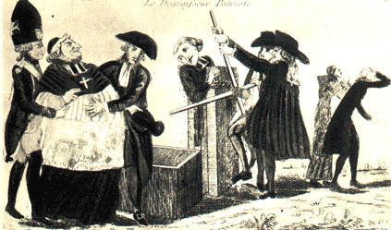
Cartoon representation of the confiscation of church lands

Slide 15
Reforms in Local Government
1) The 30 provinces and their “petty tyrants” (Intendants) were replaced with 83 new departments
-> Ruled by elected governors
2) New courts, with judges elected by the people

