Slide 1
Lesson 9 : National Assembly Legislation Assembly

Slide 2
The Civil Constitution of the Clergy (July 12, 1790)

Slide 3
The King reluctantly accepted the new constitution.
He could not accept all the reforms
+ was worried about the actions of the National Assembly
-> What’s next for the Royal Family?

Slide 4
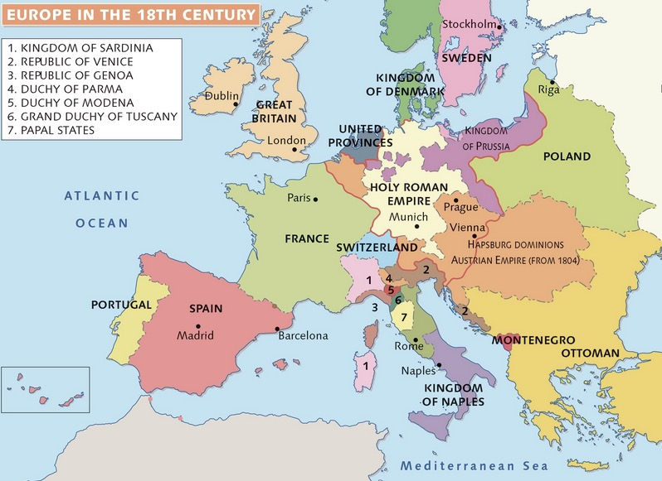
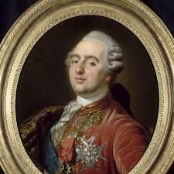
-> They decided to leave the country.
-> They sought help from Outside countries, especially Austria.

Slide 5
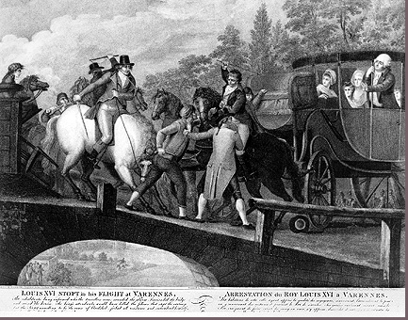
The Flight to Varennes
The royal family tried to
escape the country.
On June 20, 1791,
the King and his family
set out for the border
in a carriage.
And after?

Slide 6
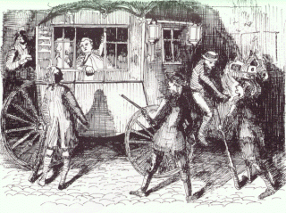
The King was disguised as a steward and his son was wearing a dress.
At the border village
of Varennes, he was
recognized and
eventually
apprehended
and imprisoned
again.
The capture of Louis XVI at Varennes

Slide 9
The news of the King's flight destroyed the last of the King's popularity with the people of Paris.
The popular press cartoon

Slide 10
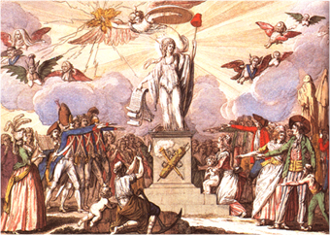
The Constitution of 1791
Since they were caught,
Louis was forced to accept
the new constitution which
created a Legislative Assembly with
which he was to share
power.
Painting depicting the 1791 constitution

Slide 11
Four Phases (Periods) of the French Revolution
National Assembly (1789-1791)
Legislative Assembly (1791-1792)
Convention (1792-1795)
Directory (1795-1799)

Slide 12
THE NATIONAL ASSEMBLY 1789-1791
Objectives
of the National Assembly
To put an end to the Ancien Régime in France.
To write a Constitution

Slide 13
8 Changes under the National Assembly
Abolishment of guilds and labor unions
Reforms in local government
Taxes levied based on the ability to pay
Many nobles left France and became known as émigrés
Declaration of the Rights of Man
Abolition of special privileges
Constitution of 1791
Equality before the law (for men)

Slide 14
Constitution of 1791
Democratic features
France became a limited/constitutional monarchy
-> King became merely the head of state
All laws were created by the Legislative Assembly
Feudalism was abolished
Undemocratic features
Voting was limited to taxpayers
Offices were reserved for property owners
-> This new government = the Legislative Assembly

Slide 15
After the Constitution had been adopted,
a new Legislative Assembly was elected to implement the legal changes.
Political parties, representing different interests, emerged…
Political groups
Girondins
Jacobins
+ Sans culottes

Slide 16
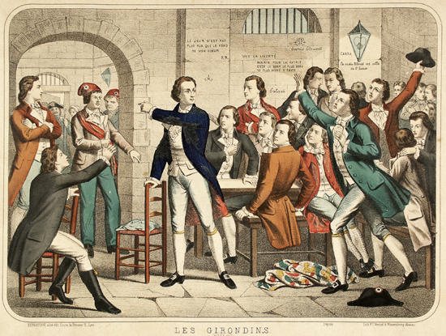
GIRONDINS
-> Believed in the revolution but represented the interests of the bourgeoisie.
-> Moderate political ideas.
They wanted to preserve the constitutional monarchy.
-> They were the voice against violence in the Assembly.
-> Liberal economic policies
that helped the middle class.
-> Limited suffrage.
Happy with the new constitution

Slide 17
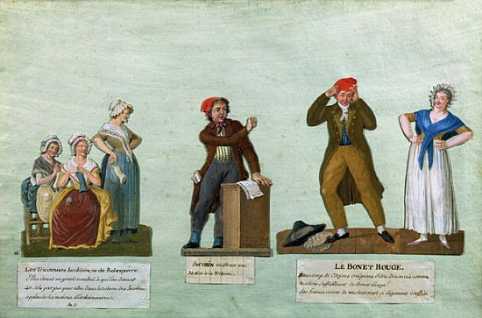
JACOBINS
Believed in the revolution
but more radical.
-> Abolition of the monarchy and put the king on trial (can not be trust)
->They demanded the establishment of a republic* + a true democracy in which all male citizens had the right to vote -> Expand the suffrage.
-> Control price rises to help workers
*A republic = a government in which the people elect representatives who will create laws and rule on their behalf

Slide 18
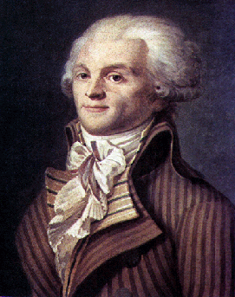
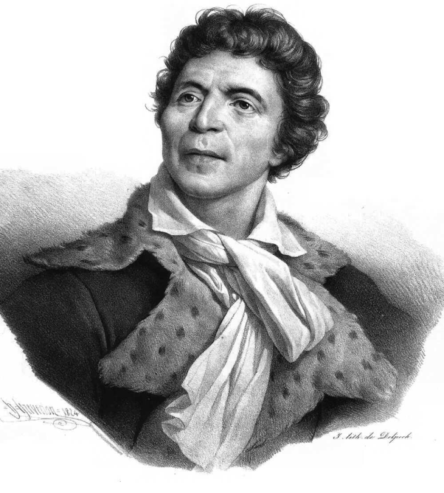
The Radical Jacobins Leaders
Maximilien Robespierre (1758-1794)
Georges Danton
(1759–1794)
Jean-Paul Marat
(1743-1793)

Slide 19
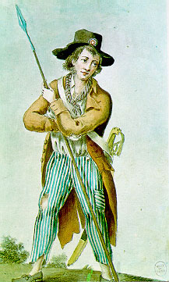
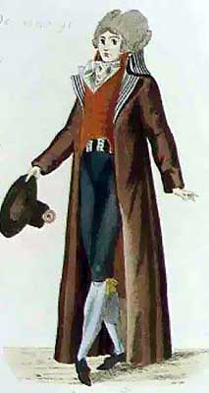
The radical Jacobins gained support of the Parisian labourers known as «san´s-cullotes»
The sans culottes
The bourgeoisie

Slide 20
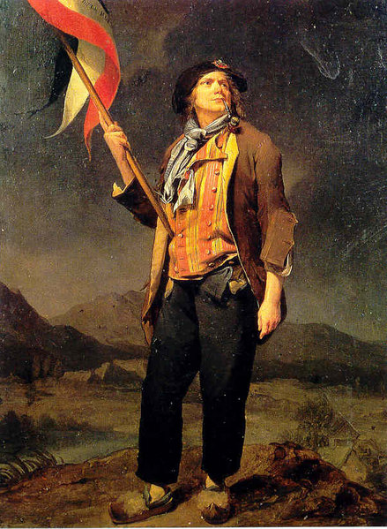
The Sans-Culottes (without trousers)
Why this name?
The working men wore loose trousers instead of the tight knee breeches of the nobility.
At the beginning of the revolution, the working men of Paris allowed the revolutionary bourgeoisie to lead them. Picked up the ideas and slogans from the more educated leadership of lawyers and journalists
But by 1790 the sans-culottes were beginning to be politically active in their own right.

