Slide 1
THE ROYAL PROVINCE OF NEW FRANCE
EUROPEAN COLONIZATION OF NORTH AMERICA
SOCIAL STUDIES 9 – PRINCE OF WALES SECONDARY

Slide 2
A NEW COLONY IS CREATED
When Champlain died, very few settlers had come to Canada.
The Iroquois controlled most of the fur trade.
1661 – An appeal is sent to Louis XIV for aid in the colony.
Louis & Jean-Baptiste Colbert (minister of the marine) were determined to make the colony strong and profitable.
Believed that mercantilism was necessary in Canada
There was plenty of wood in Canada to make barrel staves, and wood was cheapest in Canada.

Slide 3
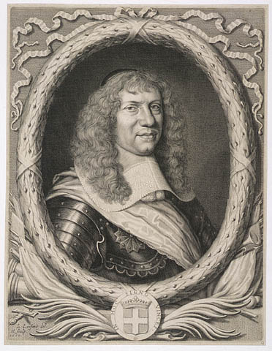
A military presence
France sends 1100 professional soldiers, which nearly doubles the population of New France.
Marquis de Tracy led a regiment against the Iroquois, attacking and burning villages until they asked for peace.
In the end:
the French control the fur trade to the West.
the Iroquois focus on expanding their territory elsewhere.

Slide 4
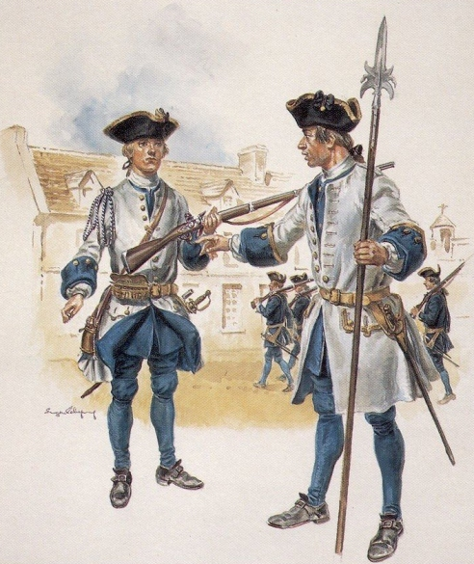
Soldiers sent over to defend the new province

Slide 5
Creation of a Royal Province
In 1663, New France becomes a Royal Province.
Frontenac becomes the first governor.
Represents the King.
Supervises defence.
Sets up treaties with Natives.
Jean Talon becomes the first intendant (to govern the local people).
Francois de Laval becomes the first bishop (to handle religious affairs, and oversee the attempts to convert natives to Christianity,
Together these three officials made up the Sovereign Council – the first government of New France.
A few settlers were on the council
The colony Louis envisions is a replica of the homeland.

Slide 6
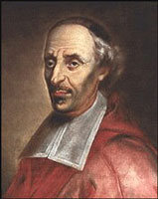
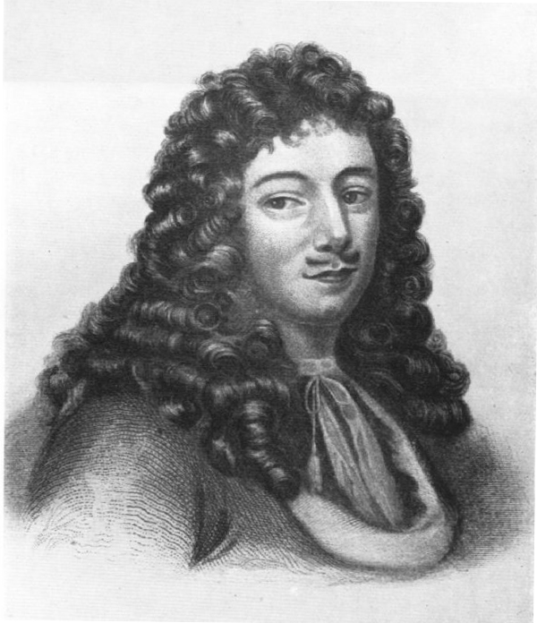
Colonial LEadership
Governor Frontenac
Bishop Laval
Intendant Talon

Slide 7
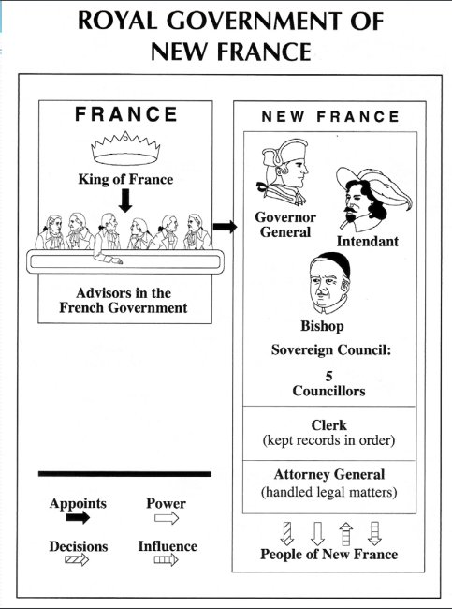

Slide 8
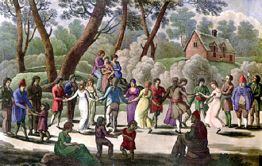
The first government
As intendant, Talon believes that the province needs the following:
Settlers
A good defence system
Basic industries
The population is increasing with the arrival of soldiers and many of them decide to permanently settle in New France.

Slide 9
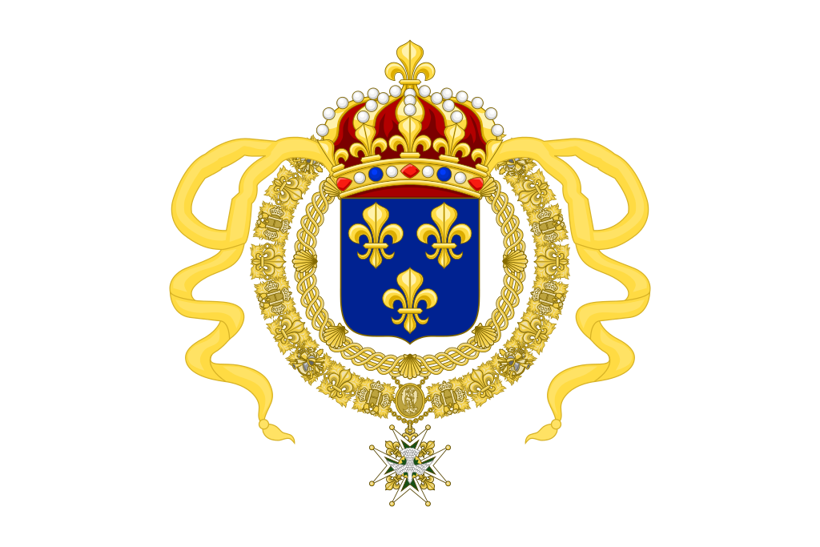
Filles du Roi
Talon recruited women from France to marry the settling soldiers.
He selects those that do not have strong ties to France, such as orphans.
Filles du Roi translates to the King’s daugters.
Hundreds of women arrive over the next 10 years.

Slide 10
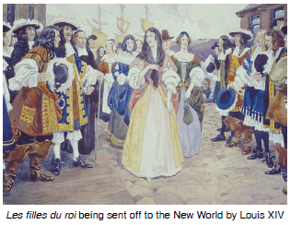

Slide 11
The mercantile system
Talon prepares the colony to enter the mercantile system:
He establishes lumber mills, a tannery, and a brewery.
Allows small ships to be built.
All of this will equal profits to France

Slide 12
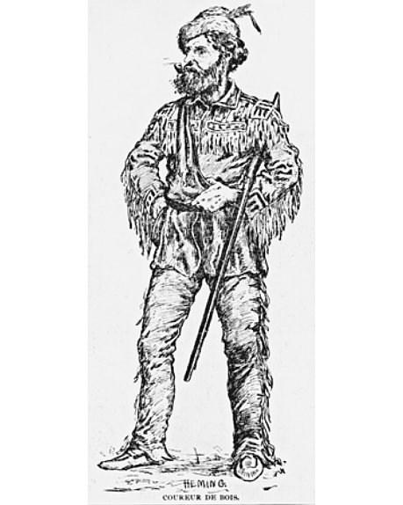
Furs & the Coureur de Bois
Governor Frontenac ordered more coureur des bois to look for more furs → as a result, the borders of the colony were expanded.
Met with the Iroquois to build a business alliance, but at the same time he was building forts to protect the French against their attacks.
He was recalled to France in 1642, but returned several years later to lead a campaign against the Iroquois.

