Slide 1
People of the Plains
First Nations Cultures of North America
Social Studies 9 – Prince of Wales Secondary

Slide 2
Location in Canada

Slide 3
Groups in Canada
Sacree
Blackfoot
Gros Venture
Assiniboin
Plains Cree
Plains Ojibwa

Slide 4
Location in the USA

Slide 5
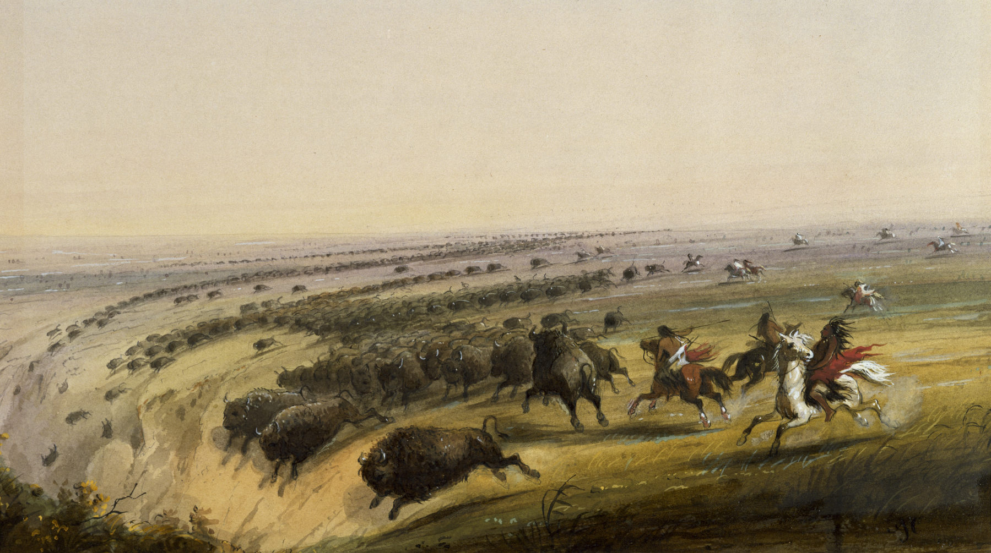
Image Analysis
What is happening in this image?
What tools or technology is being used?
Why do you think this happening?

Slide 6
Significance of the Buffalo
Buffalo was central to the Plains culture.
Provided the main source of food as well as materials for clothing, housing, and implements.
The hunt was a major group activity which required considerable planning.
Herds were either captured in corrals or stampeded over jumps where they crashed to their death.
Head-Smashed-In-Buffalo-Jump in Alberta is now the site of an excellent museum.
Plains people also ate some roots, berries, and other animals like elk and deer.
Pemmican – like jerky. Made of dried meat, pounded in to coarse powder and mixed with fat and berries.

Slide 7
Head Smashed in Buffalo Jump

Slide 8
Impact of Colonization on the Buffalo
https://www.youtube.com/watch?v=O9Sz2TGXuiM
Dramatization of the difference in cultural practices towards the buffalo.

Slide 9
Why did the Buffalo almost go extinct?
The extreme exploitation of the buffalo in the Plains region by the Plains Indians was due to the increased European influence on the Plains Indian economy and way of life.
With the augmented desire for buffalo, significant changes in economic motives, conflicts, and relations affected the Plains Indians.
Moreover, with this new economic pursuit factors like hunting, horses, and expansion all led to the ultimate demise of the buffalo population.

Slide 10
Shelter
Tipis
A tall, cone-like structure made from hides
it was waterproof and weather-hardy.
Three or four foundation poles were tied together with a piece or rawhide and raised.
Women made, owned and put up the tipis.

Slide 11
How was the Buffalo used?

Slide 12
How the parts were used:
Horns – spoons, clubs, cups, containers, head dress
Brains – Preparing hides
Skull – Religious ceremonies
Teeth – necklaces
Beard – Decoration on clothing & weapons
Hoof – boiled for glue
Dung – fuel for campfires + smoke signals
Bones – tools, scrapers, knives, weapons
Sinew – laces, thread, bowstrings (Tendons)

Slide 13
How the parts were used
Tail – Fly swatter
Hair – stuffing for balls + baby cradles, paint brushes, ropes, shields, saddles
Hide (w/o hair) – tipi covers, clothing, saddle bags
Hide (w/ hair) – winter clothes, floor coverings, moccasins, blankets
Fat – mixed with meat to make pemmican
Meat – boiled, roasted, dried
Bladder – waterproof bag
Ribs – arrow shafts, runners for sleds
Stomach – food, cooking pot, water container

Slide 14
Transportation
The Plains people were nomadic.
When moving to a new camp, family property was transported on a travois, a triangular frame of poles, dragged by dogs or horses.
Snowshoes were used during the winter by some tribes on the northern Plains.

Slide 15
Social Organization
Bands were led by Chiefs.
Chiefs were advisors
Bands would come together in the midsummer, when the buffalo were concentrated

Slide 16
Religion
Animals and other natural phenomena possessed spiritual power.
A vision quest was when an individual went to a lonely spot where he or she would fast and pray until a spiritual guardian appeared in a dream, or vision quest.
A rite of passage for young men.
The ghost dance In its earliest forms, the ritual prophesied the return of the dead and the restoration of animals then becoming scarce on the Plains.
Sun Dance – Central religious festival, see Crossroads, pg. 201
Other initiation rites?

