Slide 1
Shape of the Day
Hand in field trip forms
Presentation – People of the Plateau
Fill in note taking chart
Use your textbook to look for more details.
Organize for the in class essay – “Are First Nations People more similar or different from one another?”
Colour in map

Slide 2
People of the Plateau
Social Studies 9
First Nations People of North America

Slide 3
Location

Slide 4
Location
The Plateau cultural area consists of the high plateau between the British Columbia coastal mountains and the Rocky Mountains,
Extends south to include parts of Washington State, Oregon, Idaho, and Montana.
The Plateau peoples lived in a small region that included the southern interior of British Columbia and Alberta.

Slide 5
Languages & Nations
Languages include:
Athapaskan (Dene)
Interior Salishan
Ktunaxa
Nations:
The Carrier
The Okanangan
The Tsilhnqot’in (formely the Chicoltin)
Archaeologists suggest that at least 10,000 years ago, not long after the glaciers from the most recent ice age receded, the British Columbia Plateau was populated by indigenous peoples who had migrated northward from more southerly areas of this same Plateau.
Gradually there emerged a culture adapted to the forested mountains, sage- and cactus-covered hills, and riverine resources of the area.

Slide 6
Traditional Food
They mostly hunted deer and caribou as a source of food, mainly white-tailed deer.
The people of the Plateau also hunted smaller animals for furs and foods.
While the Plateau people were skilled hunters, the majority of their food came from the local rivers and lakes.
The single most important food to the survival of the Plateau people was the Pacific Salmon.

Slide 7
Fishing
The Plateau people developed several methods for catching salmon and other fish:
Normally salmon weirs (large traps) were set up in these public rivers to catch the salmon.
The weirs would catch a large number of fish as they tried to swim upstream to spawn.
In some areas where salmon was particularly abundant, the fish could be scooped from the water using a dip net or basket.
Men also set up wooden platforms that hung out over the river and would use dip nets or spears to catch the fish.

Slide 8
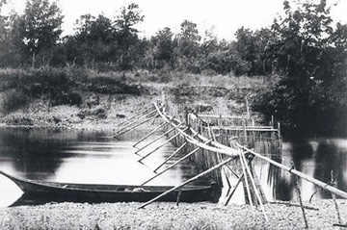
Fishing on the Rivers

Slide 9
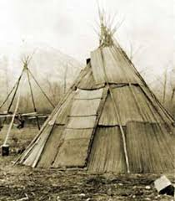
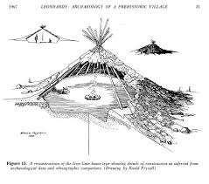
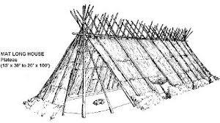
Shelter
Plateau peoples lived in three main house types: the semi-subterranean pit house, the tule-mat lodge and the tipi — a Lakota word meaning "used for dwelling in."
The Plateau peoples were semi-nomadic and their dwellings were constructed from portable, reusable materials

Slide 10
Transportation
Long distance transportation on the Plateau was done primarily by dugout canoes made from red cedar or cottonwood, or bark canoes from white pine or birch.
To travel on foot in winter, Plateau peoples used snowshoes — their designs specifically suited to the varying conditions of snow and terrain.
In this region groups of related people worked and travelled together in the spring, summer and fall, then joined with other such groups to reside in relatively permanent winter villages.

Slide 11
Spiritual Beliefs
The people of the Plateau believed strongly that there were spirits inhabiting all living and non-living things.
Some of the spirits were bad; some of the spirits were good, and they were everywhere.
The people had a strong spiritual relationship with nature, and held animals in high regard. Some of the most important ones were deer, coyotes, and horses.
Shamans
The most important religious leaders in Plateau culture were the Shamans.
The Shamans had special powers to heal the sick, control the hunt, and predict the future.
They could do so by communicating with the spirit world.
Myths
They had many myths and legends that were passed on through generations, mainly involving the creator known as 'Coyote'.
The belief was that Coyote was responsible for bringing salmon up the river every spring and fall, and for transforming people into their present day form.
Adolescence Vigils
During adolescence all Plateau people went alone on spiritual vigils.
They fasted and prayed, in hopes that a guardian spirit would appear to them in a vision.

