Slide 1
The Potlatch in the Pacific Northwest
Social Studies 9
Prince of Wales Secondary
Ms. Underwood

Slide 2
Kwakiutl
Located in BC
Name for self is Kwakwaka’wakw
Pronounced Kwak-wak-ya-wak
Means “those who speak Kwakwala”.

Slide 3
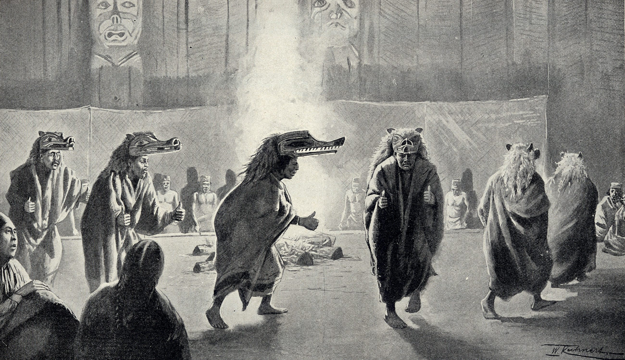
What is a Potlach?
Social institution of society
Distribution of property as gifts (ex. feasts = sharing of food)
Accompanied other events that represented change in status

Slide 4
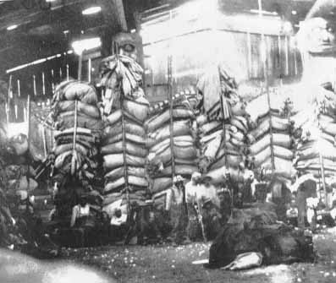
Gifts Give at Potlatch

Slide 5
Reasons for Potlatch
Birth, marriage, death, initiation as Winter dancer, assumption of new name or seat.
Present claims or changes and have them recognized.
A successful potlatch results when:
Guests accept gifts
Guests acknowledge claims in their speeches
No one objects claimes
Guests invite hosts to subsequent potlatches

Slide 6
When are Potlatches held?
The Potlatch is embedded in three features of the Kwakiutl culture:
Numaym system
Marriage system
Ceremonial system

Slide 7
Numaym System
From Kwakwala term na’mima meaning “one kind”
Basic social group of Kwakiutl; within and belonging to one tribe (similar to “houses” in Medieval Europe)
Each had its own resource sites, hereditary names, and ceremonial privileges
Also a set of ranked positions, each with its own name and certain privileges
Most positions were hereditary

Slide 8
Marriage System
Marriages were political, carefully negotiated alliances; business deal
Organized by numaym
With marriage comes a new set of names, clan ties, and privileges
Multiple marriages were encouraged
Marriages were the most important source of wealth for the potlatch

Slide 9
Ceremonial System
Tseka = Winter Dance; winter is a sacred season
Take up winter names and identify selves by role in ceremonies:
Seals = dancers
Sparrows = managers
Uninitiated persons
Dance myth
All performances required property

Slide 10
Winter Ceremonial

Slide 11
Changes to Potlatch
European invasion
Disease epidemics caused huge population loss
New commerce and goods
Political domination
European conflict led to peace between the tribes
Population loss and new wealth source led to new positions, “Eagles”
Shift from native made goods to European manufactured goods

Slide 12
Ban of the Potlatch
“Antogonistic toward the white race” and “opposed to anything and everything advanced by the white man” – Department of Indian Affairs officials
“I was told by the older men they might as well die as give up the Custom” – Agent R.H. Pidock
Banned by the Canadian government in 1885 along with the hamatsa dance
Potlatches hidden or disguised as holiday festivals when under pressure
Law went almost entirely unenforced; potlatch continued
Continues on today:

Slide 13
Additional Info on the Potlatch
Reasons cited for ban of potlatch
Health concerns (two months of nightly feasting from village to village made sickness and exposure inevitable)
Women would prostitute themselves for potlatch funds
Potlatch interrupted education
Disrupted economy – natives only worked seasonally, and didn’t save or invest money but hoarded and splurged on potlatch
Kwakiutl marriage practices viewed as immoral

Slide 14
Additional Information on the Kwakiutl
Population of the Kwakiutl before European contact was around 19,000 persons; population dropped to 2,370 in 1860s
Numaym membership”
75 in 1835
15 in 1887
10 in 1895
“Eagles” (nouveaux riches class) received gifts at potlatch before chiefs

Slide 15
Additional information on the Kwakiutl
Potlatch declined in 1920s (ironically after strict enforcement of potlatch ban had ended) for various reasons:
Great Depression
Persistence of Christian missionaries
Lack of interest among youth
Saw brief boom during wartime economy in 40s
Native cultural revival moment in 60s saw reemergence of potlatch

Slide 16
Sources
Jonaitis, Aldona, Douglas Cole, Ira Jacknis, Wayne P. Suttles, and Cloria Cranmer. Webster. Chiefly Feasts: The Enduring Kwakiutl Potlach. New York: U of Washington, 1994. Print.

