Slide 1
Phase one of the French Revolution
The National Assembly
Social Studies 9

Slide 2
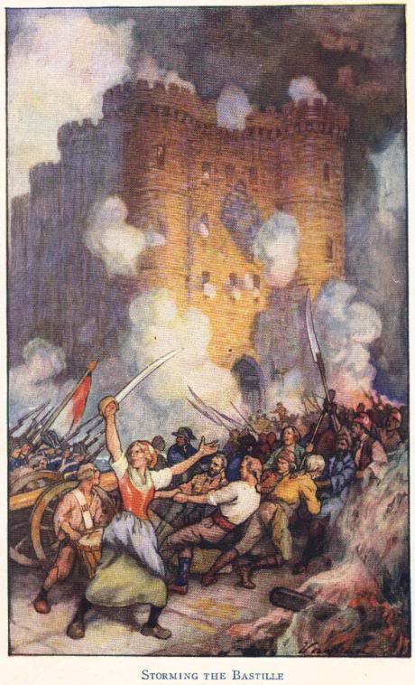
The National Assembly (1789-1791)
The first phase of the revolution began when the National Assembly was formed and began to take care of the country’s politics.
Louis XVI did not actually want a written constitution.
When news of his plan to use military force against the National Assembly reached Paris on July 14, 1789, people stormed the Bastille.

Slide 3
The Uprising Spreads
After the fall of the Bastille, the uprising spread throughout France:
Nobles were attacked
Records of feudal dues and owed taxes were destroyed
Many nobles fled the country – became known as émigrés
Louis XVI was forced to fly the new tricolor flag of France.

Slide 4
What Greater Fear?
Violent acts against the people and property of the 1st and 2nd estate, as panic and fear grew amongst the 3rd estate.
Riots were started on the grounds that there was an “aristocratic conspiracy” by the king and the privileged to overthrow the 3rd estate.
In the provinces the peasants rose against their lords, attacking chateaus and destroying feudal documents.
The Great Fear occurred in July & August of 1789.

Slide 5
Threats to one’s well-being…
Rumors spread among the peasants that nobles had hired brigands to march through the villages and destroy the peasant’s new harvest and their homes.
This fear added to the already existing fear because of the lack of good harvest in 1787.
In response, the peasants ransacked castles of the nobles and burned documents known as terriers, were recordings of feudal obligations and were locked in the châteaux.

Slide 6
Results of the Great Fear
August 4th, the nobles gave up their rights and their titles.
This lead to a new, balanced class structure, a tax decrease, and the bishops giving up their tithe.
The new, balanced class structure allowed more people to be average instead of the majority being poor, and few being excessively wealthy.
This allowed the government to be more stable and allow it to rely on itself to produce the necessities instead of outside countries.

Slide 7
More results of the Great Fear
The new tax system forced nobles to pay taxes so that the prosperity of country could grow and someday flourish.
Also, by electing a leader the ruler would have to make the people happy and not just rule by blood but rule by what was just.
Finally, the Catholic Church took a step towards becoming less corrupt because the bishops gave up their tithe, which were their one percent of taxes; this meant that they had to be based of donation and other benefits instead of living off the government.
This began the separation between church and state and gave more power to the people and less power to the church, nobles, and royalty.
The Great Fear allowed order to return to France.

Slide 8
Women’s March on Versailles
On October 4, 1789, a crowd of women demanding bread for their families gathered other discontented Parisians, including some men, and marched toward Versailles, arriving soaking wet from the rain.
They demanded to see "the Baker," "the Baker's wife," and "the Baker's boy".
The King agreed to meet with some of the women and promised to distribute all the bread in Versailles to the crowd.

Slide 9
A fatal mistake…
The National Guard arrived on the scene and was determined to take the King back to Paris.
Some of the crowd got into the Queen's quarters and Marie Antoinette barely escaped by way of a secret passage to the King's room.
He agreed to address the people from his balcony. "My friends," he said, "I will go to Paris with my wife and my children." It was a fatal mistake. It was the last time the King saw Versailles.

Slide 10
From Versailles to Paris

Slide 11
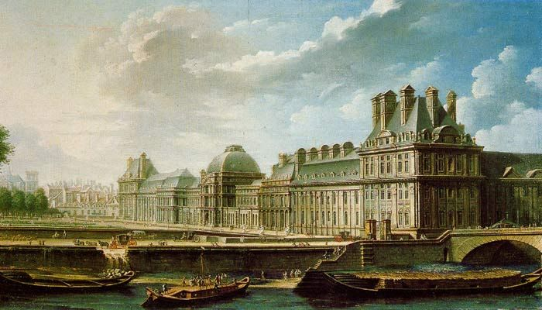
The Tuilleries
Louis XVI, Marie Antoinette, and their family were brought to the Tuileries (in Paris) where they were kept under surveillance. For the next two years the palace remained the official residence of the king.

