Slide 1
The Inuit
First Nation’s People of North America
Social Studies 9 – Ms. Underwood

Slide 2
The Inuit People

Slide 3
Terminology & Info
Inuit - Inuktitut for “the people”
the majority of whom inhabit the northern regions of Canada.
An Inuit person is known as an Inuk.
Eskimo is not a politically correct term
Although the name "Eskimo" is commonly used, this name is considered derogatory in many other places because it was given by non-Inuit people and was said to mean "eater of raw meat.“
Edmonton Eskimos???
Statistics Canada estimated that 59,440 people in Canada, about 4.2 per cent of the Aboriginal population, identified themselves as Inuit.

Slide 4
Where do the Inuit live? (add to your map)

Slide 5
Aspects of Life (Environment)

Slide 6
Aspects of Life (Environment)

Slide 7
Aspects of Life (Environment)

Slide 8
Aspects of Life (Wildlife)

Slide 9
Aspects of Life (Wildlife)

Slide 10
Aspects of Life (Wildlife)

Slide 11
Arctic Life (Wildlife) *Food web in the Arctic Ocean

Slide 12
Image Analysis
What is the object called?
Which aboriginal group is this associated with?
What do you think this object is used for?
Have you seen this image used anywhere else before?

Slide 13
Image Analysis
Why was this used in the Olympic logo?
Do you think this was a good logo to use?

Slide 14
Inuit Games
Inuit games are tests of strength, endurance, power, agility, flexibility, and hand/eye coordination.
They are significant cultural events.
Originally, Inuit games were played spontaneously and in an unstructured way.
Now, there are formal competitions such as the Arctic Winter Games (held every two years) or the World Eskimo-Indian Olympics

Slide 15
Games in action NWT Northern Games

Slide 16
Games in action Head Pull

Slide 17
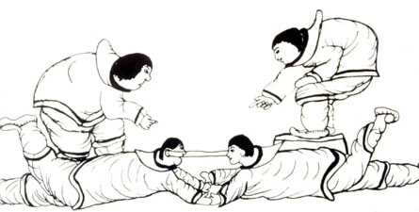
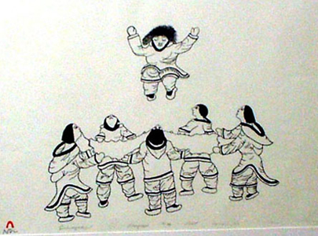
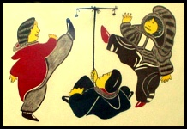
Let’s play!!
Let’s try a few Inuit games out!!
Kneel jump
Back push
Sitting knuckle pull
One foot hop

Slide 18
Looking back
Discussion
Is there a connection to the Inukshuk picture at the beginning class to the games we just played?

